Slide 1
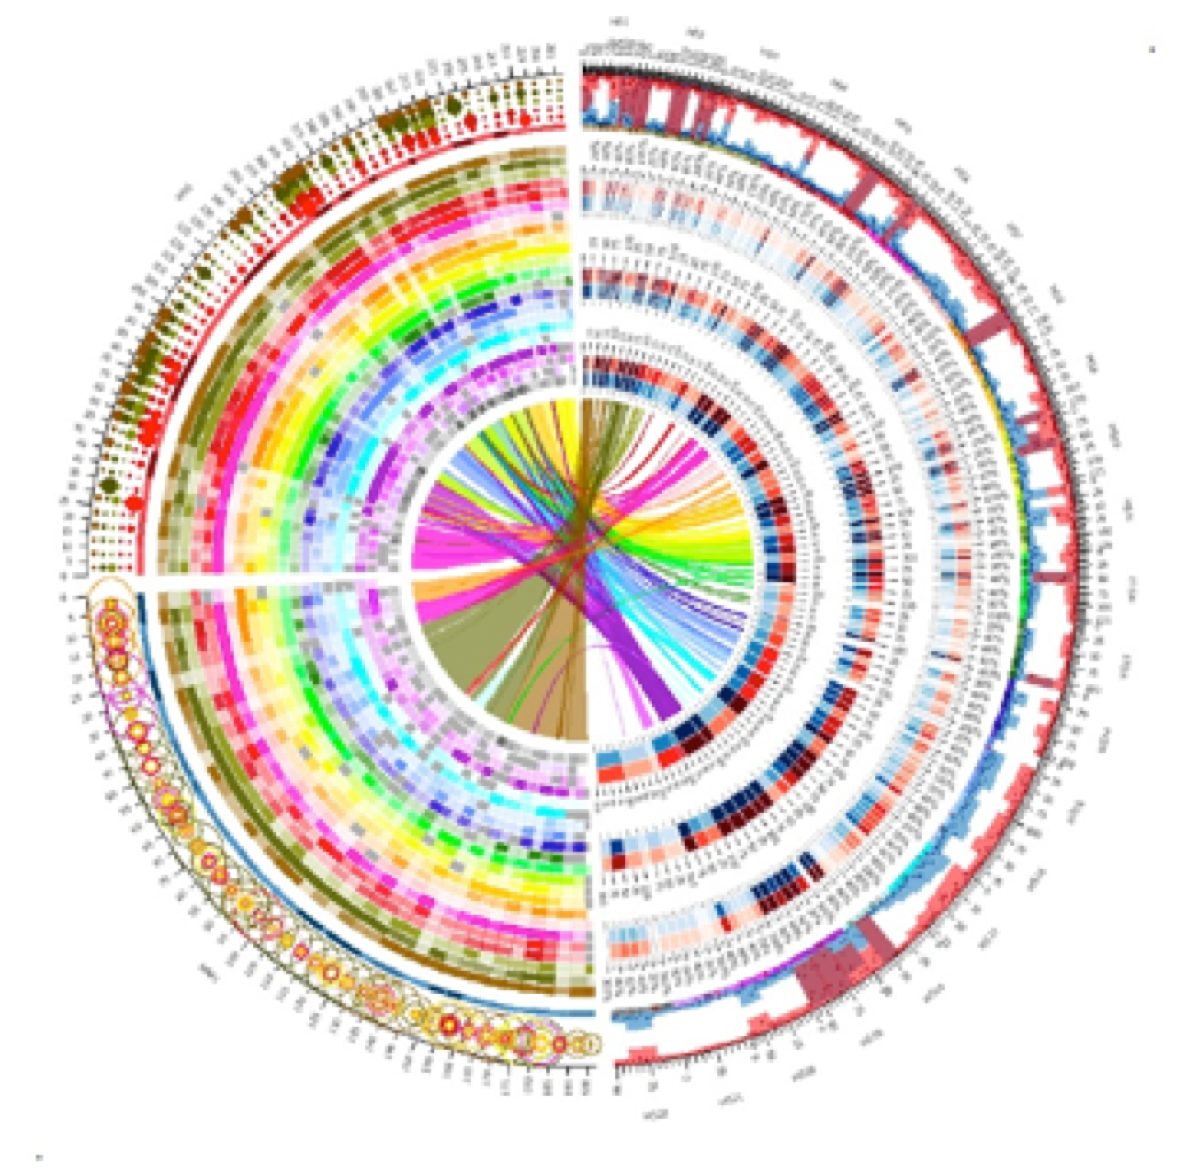
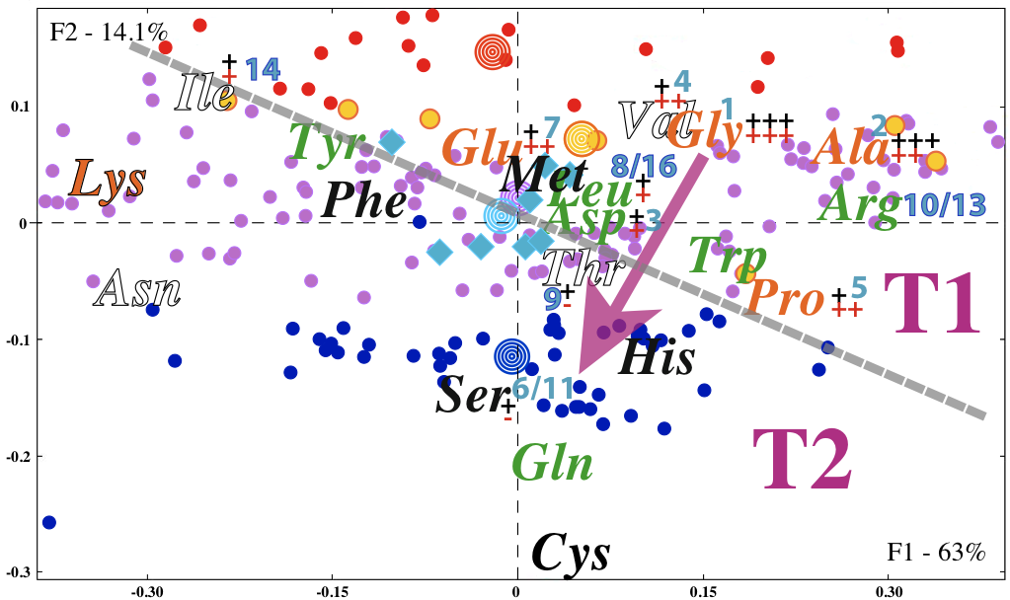
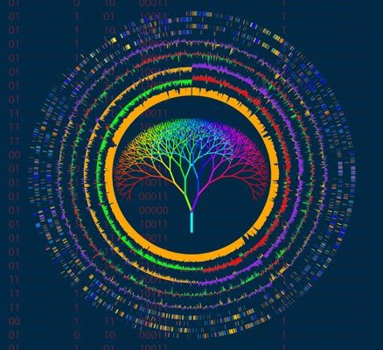
TATTTGATTTTTTGCTTAATTTTTATGTAATTACTTCCCCACAATTTTTGCCCACATATTGTGGATAAAT
ACCTTTAATCTAGAAATTACAATGAATGTTGTTGAAGAAGCACTTGGTGCTGTATTAAAAACTAAGAAGA
TTTCCACATTTTATTCACAATGTTGATAAGTTGTGTAAGTCGACTTGTTGGCTTTATAAAGCAAATGACA
CACTGAAAGTTATCCACAAACAAATTTTTCAAAAGTGTTTAAATCAAAAAGTTATCCACAAATAATGTGG
AAAACTTTTTAATAAATTTGTCGTTTCTTATGCTATCATAGTTTTACATAAATTATTAACTACTATAGGG
AGGCAGTCATGAGTCCAAACAGCACATTATGGCAGACAATATTACAGGATTTAGAAAAACTATACAACGA
GGAGACTTACAACGAGCTATTTCTACCAGTGACTTCTACTTTTAAAGATCAAAACGGATTACTTACAATG
GTTGTAGCTAATGAGTTCTTAAAGAATCGTATCAATAAACTATACATTGCAAAAATTAACGAACTTGCTA
CAAAATATTCAAGTACTCCAGTTAGATTGAAATTCGTATCACAAGAAGAAGTTATTGAAGAACCAGTAGC
TGATCGTAAATTAACCATTGATTATCGTCAAGGGAACTTAAACTCTACCTATACCTTTGACTCTTTTGTT
GTTGGAAAATCTAACATGTTTGCTTTTCGTATGGCGATGAAGGTTGCTGATCAACCTGGAGCAGTAGCAA
ACCCTTTCTACATATTTGGTGATGTAGGTTTAGGTAAAACCCATCTTATGCAAGCAATAGGTAACTATAT
ATTAGATAATGATGTCGAAAAACGTATCTTATATGTTAAAGCTGATAACTTTATTGAAGACTTTGTATCT
TTATTATCAAGAAACAAAAATAAGACTGAAGAATTCAATGCTAAATATAAAGATATTGACGTTATATTAG
TAGACGACATCCAAATTATGGCAAATGCTAGTAAAACTCAAATGGAATTCTTTAAGCTCTTTGACTACCT
ATATTTAAATAATAAACAAATCGTTATAACATCTGATAAACCAGCTTCACAATTAACAAATATCATGCCA
CGTTTAACGACACGTTTTGAAGCTGGTCTCTCTGTAGACATACAAATACCTGAATTAGAACATAGAATAA
GTATTTTAAAGAGAAAAACAGCTACATTAGATGCCAACTTAGAGGTAAGTGAGGATATTTTAACCTTTAT
AGCATCTCAATTTGCAGCAAACATTAGAGAAATGGAAGGTGCACTCATTCGTTTAATTAGTTATGCACAG
ACCTTTAATCTAGAAATTACAATGAATGTTGTTGAAGAAGCACTTGGTGCTGTATTAAAAACTAAGAAGA
AAACAAATGATTTAAACGAAAATAACTACGATAAGATCCAAAGTATTGTAGCAGATTACTTCCAAGTTTC
ATTACCAGACTTAATTGGTAAGAAAAGACATGCTAAATTCACATTACCTAGACATATAGCGATGTATCTT
ATTAAACTTAAATACAATATTCCTTATAAAACAATTGGATCTTTATTTAATGATAGAGACCACTCCACAG
TATTATCTGCTTGTGAAAAAGTAGAACGCGATATGAGGATGGATTCGAACTTAAAGTTTGCTGTTGACTC
GATTGTCAAAAAAATAGATTCACCATTATTAAAGTGATAAATGTTTATAAAAATGATTAAATGTGGTAAA
ATAAATGGTAGATGAAGCGATTATTGCTAGTTTCCCACTTTCCCACAGACACTAACAATAACAAAGAAGA
AATAATAATTAATAAAAGGGGTAAAATATGAATTTTACAATTGAAAGAGATATACGTTCAGTTAACCGGA
Large-scale Genome Analyses
Fredj Tekaia
tekaia@pasteur.fr
Bioinformatics and Genome Analyses
Institut Pasteur Tunis, Tunisia. September 18 – December 15, 2017

Slide 2
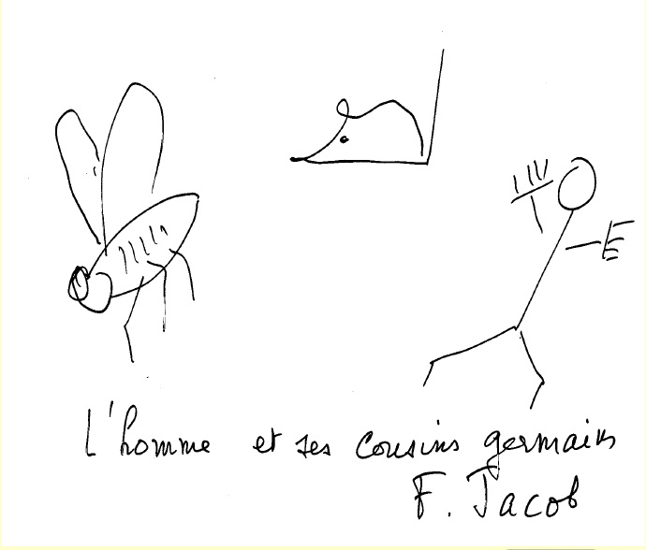

Slide 3
Plan
I- Large-scale Genomes Analyses
(knowledge so far acquired)
II- Horizontal Gene Transfer
III- Orthologs, paralogs inference and clustering methods
(context - difficulties – limitations)
IV- Phylogeneomics …
V- Genomic variation

Slide 4
Plan
I- Large-scale Genomes Analyses
(knowledge so far acquired)
II- Horizontal Gene Transfer
III- Orthologs, paralogs inference and clustering methods
(context - difficulties – limitations)
IV- Phylogeneomics …
V- Genomic variation

Slide 5
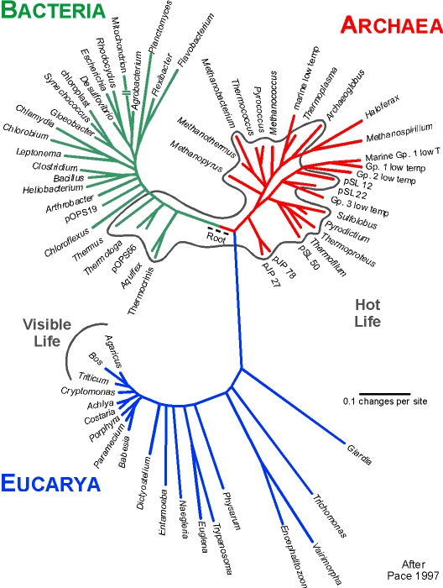
11/10/2017
TATTTGATTTTTTGCTTAATTTTTATGTAATTACTTCCCCACAATTTTTGCCCACATATTGTGGATAAAT
ACCTTTAATCTAGAAATTACAATGAATGTTGTTGAAGAAGCACTTGGTGCTGTATTAAAAACTAAGAAGA
TTTCCACATTTTATTCACAATGTTGATAAGTTGTGTAAGTCGACTTGTTGGCTTTATAAAGCAAATGACA
CACTGAAAGTTATCCACAAACAAATTTTTCAAAAGTGTTTAAATCAAAAAGTTATCCACAAATAATGTGG
AAAACTTTTTAATAAATTTGTCGTTTCTTATGCTATCATAGTTTTACATAAATTATTAACTACTATAGGG
AGGCAGTCATGAGTCCAAACAGCACATTATGGCAGACAATATTACAGGATTTAGAAAAACTATACAACGA
GGAGACTTACAACGAGCTATTTCTACCAGTGACTTCTACTTTTAAAGATCAAAACGGATTACTTACAATG
GTTGTAGCTAATGAGTTCTTAAAGAATCGTATCAATAAACTATACATTGCAAAAATTAACGAACTTGCTA
CAAAATATTCAAGTACTCCAGTTAGATTGAAATTCGTATCACAAGAAGAAGTTATTGAAGAACCAGTAGC
TGATCGTAAATTAACCATTGATTATCGTCAAGGGAACTTAAACTCTACCTATACCTTTGACTCTTTTGTT
GTTGGAAAATCTAACATGTTTGCTTTTCGTATGGCGATGAAGGTTGCTGATCAACCTGGAGCAGTAGCAA
ACCCTTTCTACATATTTGGTGATGTAGGTTTAGGTAAAACCCATCTTATGCAAGCAATAGGTAACTATAT
ATTAGATAATGATGTCGAAAAACGTATCTTATATGTTAAAGCTGATAACTTTATTGAAGACTTTGTATCT
TTATTATCAAGAAACAAAAATAAGACTGAAGAATTCAATGCTAAATATAAAGATATTGACGTTATATTAG
TAGACGACATCCAAATTATGGCAAATGCTAGTAAAACTCAAATGGAATTCTTTAAGCTCTTTGACTACCT
ATATTTAAATAATAAACAAATCGTTATAACATCTGATAAACCAGCTTCACAATTAACAAATATCATGCCA
CGTTTAACGACACGTTTTGAAGCTGGTCTCTCTGTAGACATACAAATACCTGAATTAGAACATAGAATAA
GTATTTTAAAGAGAAAAACAGCTACATTAGATGCCAACTTAGAGGTAAGTGAGGATATTTTAACCTTTAT
AGCATCTCAATTTGCAGCAAACATTAGAGAAATGGAAGGTGCACTCATTCGTTTAATTAGTTATGCACAG
ACCTTTAATCTAGAAATTACAATGAATGTTGTTGAAGAAGCACTTGGTGCTGTATTAAAAACTAAGAAGA
AAACAAATGATTTAAACGAAAATAACTACGATAAGATCCAAAGTATTGTAGCAGATTACTTCCAAGTTTC
ATTACCAGACTTAATTGGTAAGAAAAGACATGCTAAATTCACATTACCTAGACATATAGCGATGTATCTT
ATTAAACTTAAATACAATATTCCTTATAAAACAATTGGATCTTTATTTAATGATAGAGACCACTCCACAG
TATTATCTGCTTGTGAAAAAGTAGAACGCGATATGAGGATGGATTCGAACTTAAAGTTTGCTGTTGACTC
GATTGTCAAAAAAATAGATTCACCATTATTAAAGTGATAAATGTTTATAAAAATGATTAAATGTGGTAAA
ATAAATGGTAGATGAAGCGATTATTGCTAGTTTCCCACTTTCCCACAGACACTAACAATAACAAAGAAGA
AATAATAATTAATAAAAGGGGTAAAATATGAATTTTACAATTGAAAGAGATATACGTTCAGTTAACCGGA
Complete sequenced genomes: 8319
• 7656 Bacteria
• 258 Archaea
• 405 Eukaryotes
7656
258
Massive amounts of genome sequences available for analyses and studies
Incomplete genomes: 15462
• 10682 Bacteria
• 294 Archaea
• 4886 Eukaryotes
Opportunity for in-silico researchers to transform these raw data into scientific knowledge
Tree of life
Permanent Draft genomes: 70185
• 65162 Bacteria
• 779 Archaea
• 4244 Eukaryotes
405
Transciptomes: 73/9302
• 51/1017 Bacteria
• 0/160 Archaea
• 24/13220 Eukaryota
https://gold.jgi.doe.gov
Viruses: • Completed: 3504 • Permanent draft: 4450
Notes:
Bioinformatician take advantages of the available data to perform their research and expect new discoveries.

Slide 6
Mathematics
Statistics
Bioinformatics
Nucleotide & protein sequences and related information
Biology
Computer Science

Slide 7
Genomes: Simple description

Slide 8
Genomic data related to 3524 completely sequenced species
Tekaia F. 2017. Unpublished results.

Slide 9
Number of proteins/genome
#Proteins | #Species | Mean | STD | Min | Max | Median
Bacteria | 2609 | 3182.9 | 1761.0 | 116 | 10400 | 2926
Archaea | 160 | 2360.0 | 797.8 | 540 | 5113 | 2186
Eukaryotes | 174 | 13482.7 | 11489.5 | 466 | 63235 | 9204
Fungi | 83 | 7825.9 | 3261.0 | 1831 | 17608 | 6272
Virus | 4331 | 47.3 | 93.0 | 1 | 2541 | 7
Tekaia F. 2017. Unpublished results.

Slide 10
Mean Protein Size per Domain
Tekaia F. 2017. Unpublished results.

Slide 11
Mean Coding Potential per Domain
Coding Potential = Size of coding regions / genome size
= percent of coding region.
Tekaia F. 2017. Unpublished results.

Slide 12
Mean GC composition/Domain
Tekaia F. 2017. Unpublished results.

Slide 13
Proteomes: Amino acid compositions

Slide 14
Evolution of Proteomes:
Signatures and Trends in Amino Acid Compositions
• Are there specific properties associated with lifestyles and with phylogeny?
• What are the underlying evolutionary trends?
Tekaia, F. and Yeramian, E. (2006). Evolution of Proteomes: Fundamental signatures and global trends in amino acid composition. BMC Genomics. 7:307.

Slide 15
Amino Acid composition of 208 proteomes
including:
• 20 hyperthermophiles (HTH) (OGT >60°C up to 120°C),
• 7 thermophiles (TH) (OGT >50°C up to 60°C),
• 8 psychrophiles (PSYC) (OGT: -10°C, up to 15°C),
• 173 mesophiles (BMES) including 53 eukaryotes (EUK)
Data table: 222 (208 + 14 sup) vs 23 (20 aa + pol, char, hyd)
http://www.ncbi.nlm.nih.gov/entrez/query.fcgi?db=genomeprj
+ specific sites

Slide 16
Amino Acid composition
208
...............
13
Correspondence Analysis was used to explore relationships between species and amino acids.

Slide 17
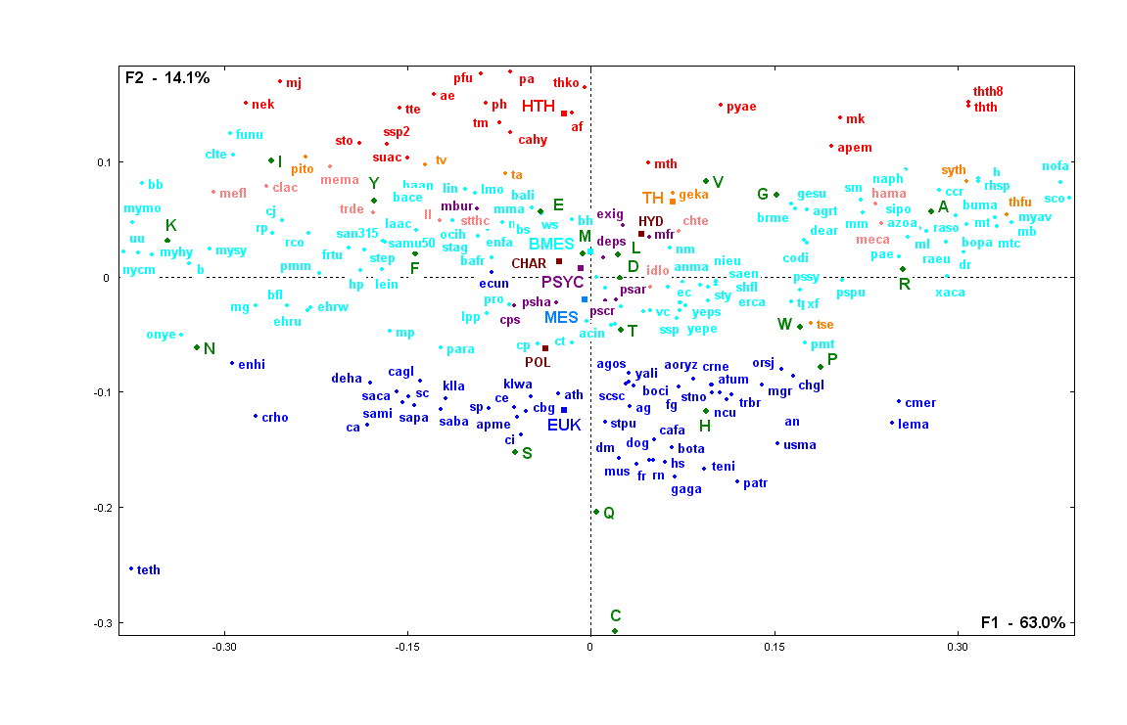
Pyrococcus abyssi:44%
Methanococcus jannaschii:31%
growth t°
Thermus-thermophilus:69%
•
Hyperthermophiles
Methanopyrus kandleri:61%
Nocardia farcinica:70%
•
Thermophiles
Mycoplasma mycoides
23%
•
Streptomyces coelicolor: 72%
Encephalitozoon cuniculi
Psychrophiles
Prokaryotes mesophiles
•
Colwellia psychrerythraea
GC%
Pseudoalteromonas haloplanktis
Entamoeba histolytica (Protists)
•
Cyanidioschyzon merolae
Cryptosporidium hominis
Eukaryotes
Leishmania major:60%
Saccharomyces
A. nidulans
Candida Glabrata
Aspergilus fumigatus:50%
Homo sapiens
A. oryzae
Mus musculus
C. neoformans
Tetrahymena thermophila (Protists)
Rat
Tekaia, F. and Yeramian, E. (2006). Evolution of Proteomes: Fundamental signatures and global trends in amino acid composition. BMC Genomics. 7:307.

Slide 18
Tekaia, F. and Yeramian, E. (2006). Evolution of Proteomes: Fundamental signatures and global trends in amino acid composition. BMC Genomics. 7:307.
Miller, S.L. Science 117, 528-529. (1953)
Cronin, J.R. and Pizzarello, S. (1983).

Slide 19
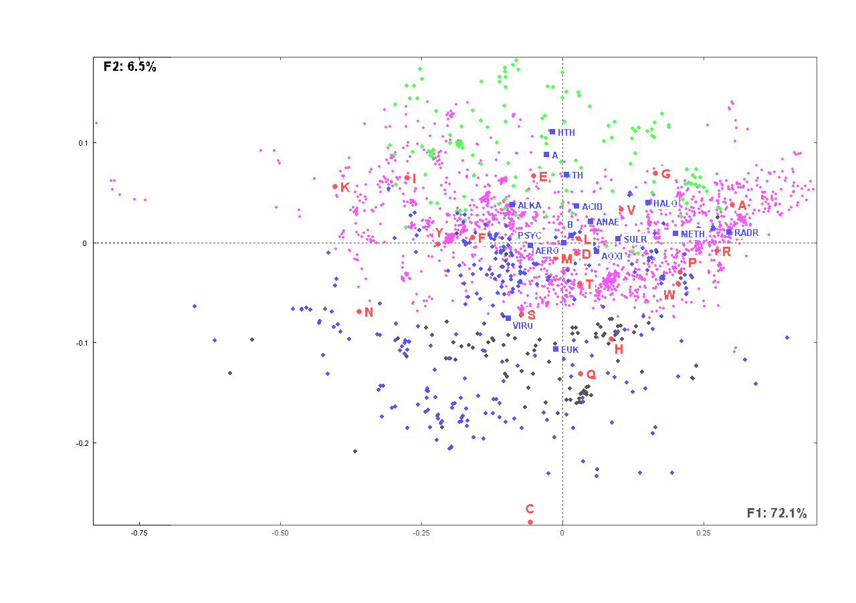
Bacteria | 2127
Archaea | 145
Eukaryotes | 95
Giant Viruses | 273

Slide 20
Genome Analyses

Slide 21
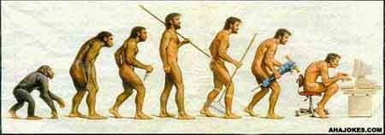
"Nothing in Biology makes sense except in the light of evolution”
Christian Theodosius Dobzhansky, 1973.

Slide 22
Search for similarity
One of the most frequent activity in Bioinformatics
Common ancestor
Two genes are homologs if and only if they derive from the same ancestor
Gene1
Gene2
Homology is almost uniquely inferred by sequence similarity

Slide 23
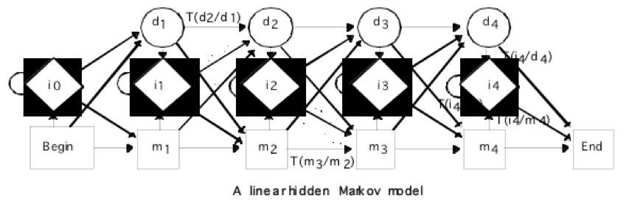
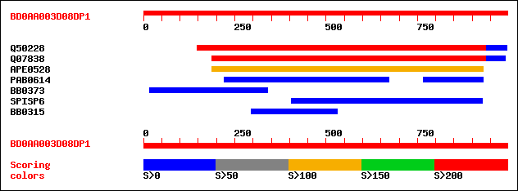
Sequence similarity search
V I T K L G T C V G S V I T K L G T C V G S
V I S . . . T Q V G S V . S K . G T Q V . S
• Smith-Waterman algorithm
• FASTA
• HMM (Hidden Markov Model)
• BLAST
• Identity
• Similarity
• Homology

Slide 24
Significant homology
meaningless
Weak homology
Significant similarity
Weak similarity
Beware : significant or weak homology are meaningless!
• Sequence similarity is a measure of the matching characters in an alignment, whereas homology is a statement of common evolutionary origin.

Slide 25
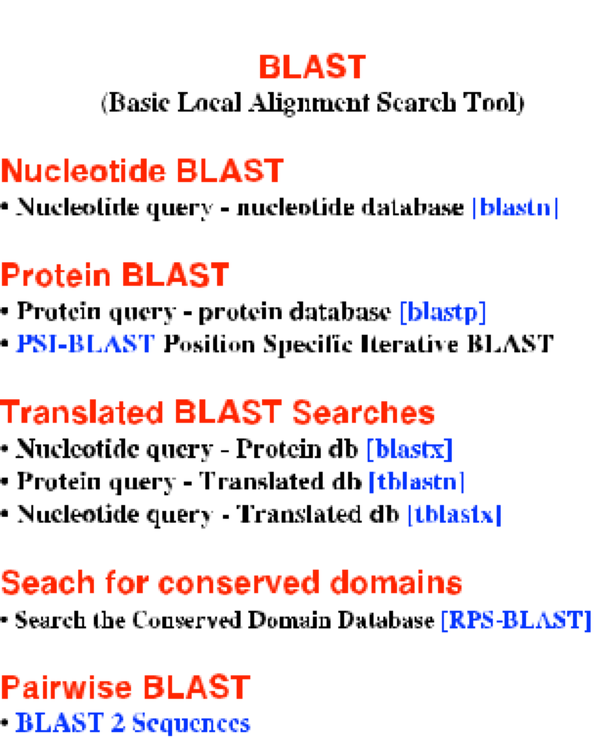
Sequence similarity search
http://blast.ncbi.nlm.nih.gov/Blast.cgi

Slide 26
Bioinformatics in the genome era
•Gene prediction resources
•Large-scale genome comparisons
•Paralogs, Orthologs inference and clustering
•Phylogenomics
•Whole genome alignments
•Relationships visualization
New tools and methods for NGS data analyses

Slide 27
Large-scale genome comparisons
•Duplication (genes, chromosome segments, whole genome)
•Conservation (genes, chromosomes segments);
•Specificity (species-specific genes);
•Inferring Paralogs, orthologs;
•Families (clusters) of paralogs, of orthologs;
• Shared motifs in clusters of paralogs, orthologs;
• Protein conservation profiles;
•Gene Transfer, introgression between species;

Slide 28
Comparative genomics
• Analysis and comparison of genomes from different species.
=> Help understanding the similarity and differences between genomes, their evolution and the evolution of their genes.
• Intra-genomic comparisons: degree of duplication (genome regions; genes) and genes organization,...
• Inter-genomic comparisons: degree of similarity between genomes; degree of conservation between genes;
Determination of syntenic regions i.e regions conserved in different species;

Slide 29
Comparing genomes: All versus All
Intra-species
A
A
Inter-species
A
C
B

Slide 30
Large-scale comparative analyses of predicted proteomes revealed significant evolutionary processes:
Expansion, Exchange and Deletion.
Evolutionary processes include
Expansion*
Ancestor
duplication
Phylogeny*
segmental dup.
Whole Genome Dup.
genesis
HGT
species genome
HGT
introgression
Exchange*
Deletion*
Rearrangements*
loss

Slide 31
Comparing genomes
Intra-species comparisons
A
A
• Rate of ancestral duplication
i.e number of genes that are not unique relative to the total number of genes in A.
• Families of genes - Orphans - Organisation

Slide 32
Gene duplications are traditionally considered as a major evolutionary source for protein new functions
Understanding how duplications happened and how important is this evolutionary process is a key goal of genome analysis
> Examples

Slide 33
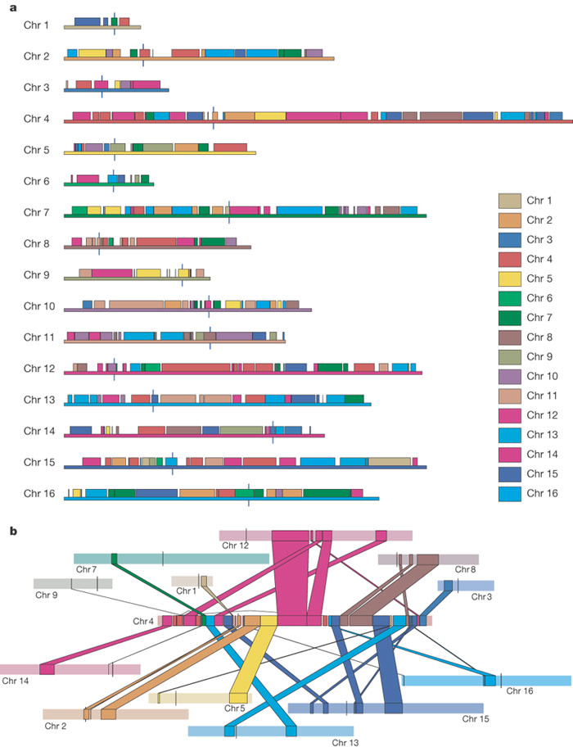
S. cerevisiae genome
Colours reveal Duplicated Blocks
Kellis et al. 2004. Nature, 428:617-24.

Slide 34
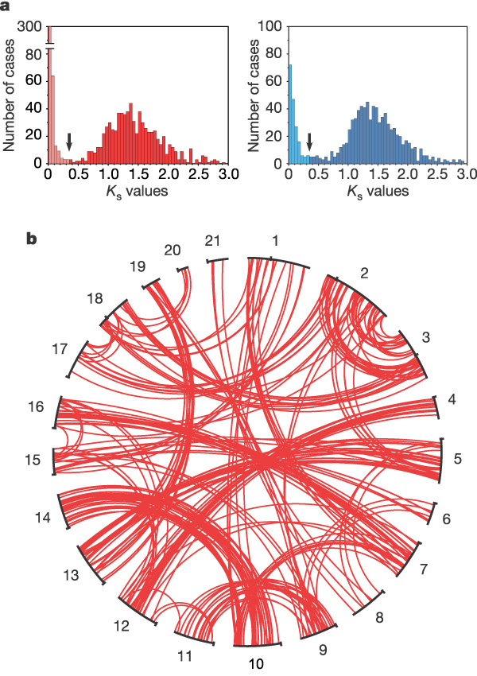
Genome duplication.
a, Distribution of Ks values of duplicated genes in Tetraodon (left) and Takifugu (right) genomes. Duplicated genes broadly belong to two categories, depending on their Ks value being below or higher than 0.35 substitutions per site since the divergence between the two puffer fish (arrows).
b, Global distribution of ancient duplicated genes (Ks > 0.35) in the Tetraodon genome. The 21 Tetraodon chromosomes are represented in a circle in numerical order and each line joins duplicated genes at their respective position on a given pair of chromosomes.
Tetraodon genomes
Jaillon et al. Nature 431, 946-857. 2004.

Slide 35
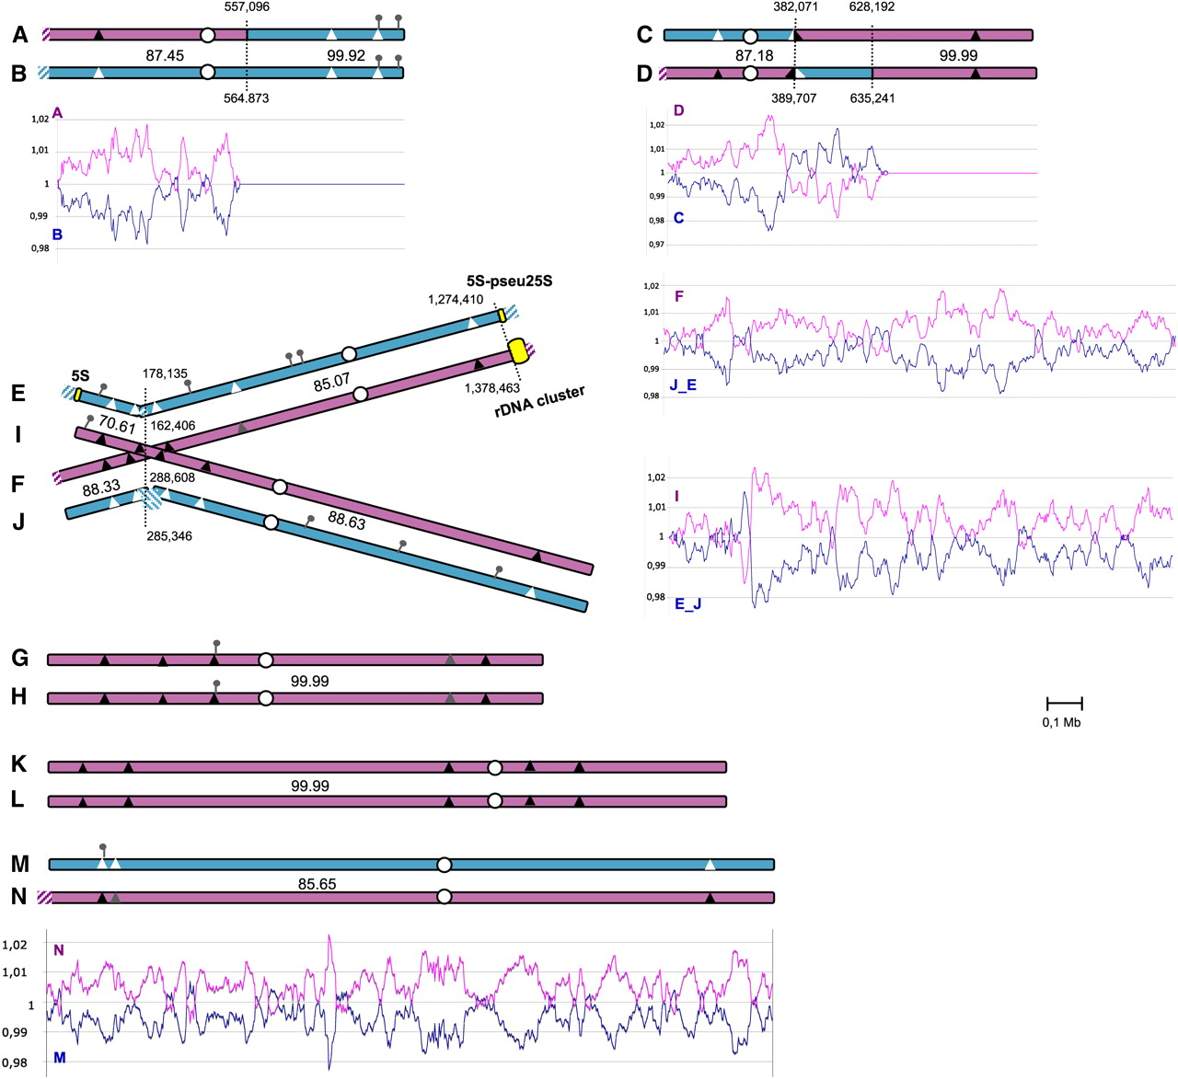
The hybrid nuclear genome of P. sorbitophila.
Whole genome duplication Pichia sorbitophila
Louis et al. G3. 2;299-311. (2012).
©2012 by Genetics Society of America
Notes:
The hybrid nuclear genome of P. sorbitophila. The 14 chromosomes are represented by pairs according to their synteny. Chromosomes A/B and C/D are partly heterozygous, partly homozygous. Chromosomes E/F/I/J and M/N are heterozygous, and G/H and K/L are homozygous. The translocation breakpoint observed between chromosomes E, F, I, and J is represented by crossed chromosomes. Red and blue colors correspond to the proposed Pγ and Pε parental subgenomes, respectively, and hatched boxes to synteny losses between the homeologous chromosomes. Percentages of nucleotide identity between heterozygous regions are also indicated. Position of predicted centromeres (Figure S4) and of the 15 clusters of NUMT loci comprising a total of 24 NUMTs (Table S3) are shown by white dots and pins, respectively. Triangles indicate the positions of selected sequences used in P. farinosa CBS2001 strain (Table S4). The nucleotide identity level observed between P. sorbitophila and P. farinosa for the selected sequences is represented as followed: black triangles for 100% identity, gray for 99% and white for less than 96%. Below each chromosome pair (or at right for the crossed chromosomes) is represented the GC content variation (as shown in Materials and Methods and Figure S5) calculated for genes present at two allelic copies in chromosome pairs. The colors for curves correspond to subgenomes as for chromosomes.

Slide 36
Comparing genomes
Inter-species comparisons
A
C
B
• Rate of ancestral conservation of one species in another species;
• Orthologs - synteny - introgression - loss - HGT …

Slide 37
Examples
Comparing S. cerevisiae (SACE) proteome with C. elegans (CAEL) proteome

Slide 38
SACE vs SACE

Slide 39
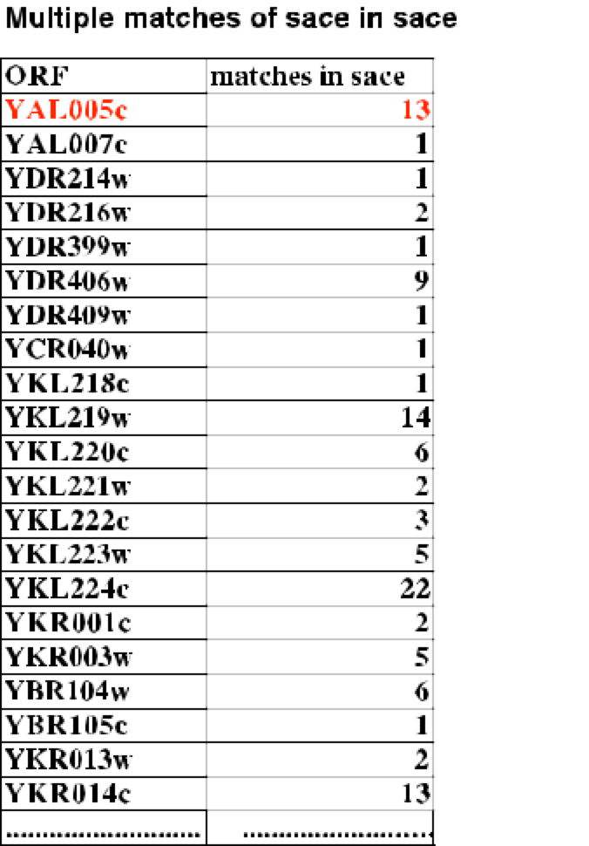
- Orphans
- Paralogs - multiple matches
- Partitions/clustering

Slide 40
SACE/CEEL
CEEL/SACE
Reciprocal Best Hits (RBH)

Slide 41
How to assess Significance of Sequence Similarity?
• In most all versus all comparisons analyses (using BLAST) an arbitrary e-value limit is set (varying from e-value=0.01 to e-value= 1e-100 or lower) to consider the significance of similarity between the query sequence and a hit sequence.
• More efficient methods assess sequence similarity significance based on specified thresholds: percent identity and length of overlapping conservation.
(with diverse figures for percent identity and length.)

Slide 42
Query= YAL005c ATPase involved in protein folding and nuclear...
(642 letters)
.....................
CEC37H5.8 CE08631 WBGene00002010 locus:hsp-6 heat shock 70 prote... 556 e-158
>C37H5.8 locus:hsp-6 heat shock 70 protein status:Partially_confirmed SW:P11141
Length = 657
Score = 556 bits (1432), Expect = e-158, Method: Composition-based stats.
Identities = 322/641 (50%), Positives = 426/641 (66%), Gaps = 23/641 (3%)
Query: 5 VGIDLGTTYSCVAHFANDRVDIIANDQGNRTTPSFVAFT-DTERLIGDAAKNQAAMNPSN 63
+GIDLGTT SCV+ +I N +G RTTPS VAFT D ERL+G AK QA N +N
Sbjct: 34 IGIDLGTTNSCVSIMEGKTPKVIENAEGVRTTPSTVAFTADGERLVGAPAKRQAVTNSAN 93
Query: 64 TVFDAKRLIGRNFNDPEVQADMKHFPFKLIDVDGKPQIQVEFKGETKNFTPEQISSMVLG 123
T+F KRLIGR + DPEVQ D+K P+K++ VE +G K ++P Q+ + VL
Sbjct: 94 TLFATKRLIGRRYEDPEVQKDLKVVPYKIVKASNG-DAWVEAQG--KVYSPSQVGAFVLM 150
Query: 124 KMKETAESYLGAKVNDAVVTVPAYFNDSQRQATKDAGTIAGLNVLRIINEPTAAAIAYGL 183
KMKETAESYLG VN+AVVTVPAYFNDSQRQATKDAG I+GLNVLR+INEPTAAA+AYGL
Sbjct: 151 KMKETAESYLGTTVNNAVVTVPAYFNDSQRQATKDAGQISGLNVLRVINEPTAAALAYGL 210
Query: 184 DKKGKEEHVLIFDLGGGTFDVSLLSIEDGIFEVKATAGDTHLGGEDFDNRLVNHFIQEFK 243
DK ++ + ++DLGGGTFDVS+L I+ G+FEVK+T GDT LGGEDFD+ LV+H + EFK
Sbjct: 211 DKDAGDKIIAVYDLGGGTFDVSILEIQKGVFEVKSTNGDTFLGGEDFDHALVHHLVGEFK 270
Query: 244 RKNKKDLSTNQRALRRLRTACERAKRTLSSSAQTSVEIDSLFEGID----FYTSITRARF 299
++ DL+ + +A++RLR A E+AK LSS+ QT + + + +TRA+F
Sbjct: 271 KEQGVDLTKDPQAMQRLREAAEKAKCELSSTTQTDINLPYITMDQSGPKHLNLKLTRAKF 330
Query: 300 EELCADLFRSTLDPVEKVLRDAKLDKSQVDEIVLVGGSTRIPKVQKLVTDYFNGKEPNRS 359
E++ DL + T++P K L DA++ SQ+ +++LVGG +R+PKVQ V + F GK P+++
Sbjct: 331 EQIVGDLIKRTIEPCRKALHDAEVKSSQIADVLLVGGMSRMPKVQATVQEIF-GKVPSKA 389
Query: 360 INPDEAVAYGAAVQAAILTGDESSKTQDLLLLDVAPLSLGIETAGGVMTKLIPRNSTIPT 419
+NPDEAVA GAA+Q A+L GD D+LLLDV PLSLGIET GG+MTKLI RN+TIPT
Sbjct: 390 VNPDEAVAMGAAIQGAVLAGD----VTDVLLLDVTPLSLGIETLGGIMTKLITRNTTIPT 445
Query: 420 KKSEIFSTYADNQPGVLIQVFEGERAKTKDNNLLGKFELSGIPPAPRGVPQIEVTFDVDS 479
KKS++FST AD Q V I+VF+GER N LLG+F L GIPPAPRGVPQ+EVTFD+D+
Sbjct: 446 KKSQVFSTAADGQTQVQIKVFQGEREMATSNKLLGQFSLVGIPPAPRGVPQVEVTFDIDA 505
Query: 480 NGILNVSAVEKGTGKSNKITITNDKGRLSKEDIEKMVAEAEKFKEEDEKESQRIASKNQL 539
NGI+NVSA ++GTGK +I I + G LSK+ IE M+ EAEK ED K + + NQ
Sbjct: 506 NGIVNVSARDRGTGKEQQIVIQSSGG-LSKDQIENMIKEAEKNAAEDAKRKELVEVINQA 564
Query: 540 ESIAYSLKNTISEAGDKLEQADKDTVTKKAEETISWLDSNTTASKEEFDDKLKELQDIAN 599
E I + + ++E D+L + + + + K +T LD+ + E + LQ +
Sbjct: 565 EGIIHDTEAKMTEFADQLPKDECEALRTKIADTKKILDNKDNETPEAIKEACNTLQQQSL 624
Query: 600 PIMSKLYQAGGAPGGAAGGAPGGFPGGAPPAPEAEGPTVEE 640
+ Y+ A G A A AE P E+
Sbjct: 625 KLFEAAYKNMAAKNSG---------GDAQEAKTAEEPKKEQ 656

Slide 43
e-value limit for statistical significance?
Can be determined by simulation considering:
• Sets of random sequences generated for example with sizes and compositions equal to the average size and amino acid composition of the proteome of a given species.
• Each random sequence is compared to the cognate species proteome, and the best probability scores are recorded.
Tekaia F, Dujon B. Pervasiveness of gene conservation and persistence of duplicates in cellular genomes. J Mol Evol.; 1999; 49(5):591-600.

Slide 44
Random proteome
Original proteome
n random sequences
blastp
n original sequences

Slide 45
• Random seq with size and amino-acids composition equal to the average seq size and proteome aa composition.
• Comparison of random sequences vs cognate proteome
->Limit of significance: first significant change between adjacent e-values

Slide 46
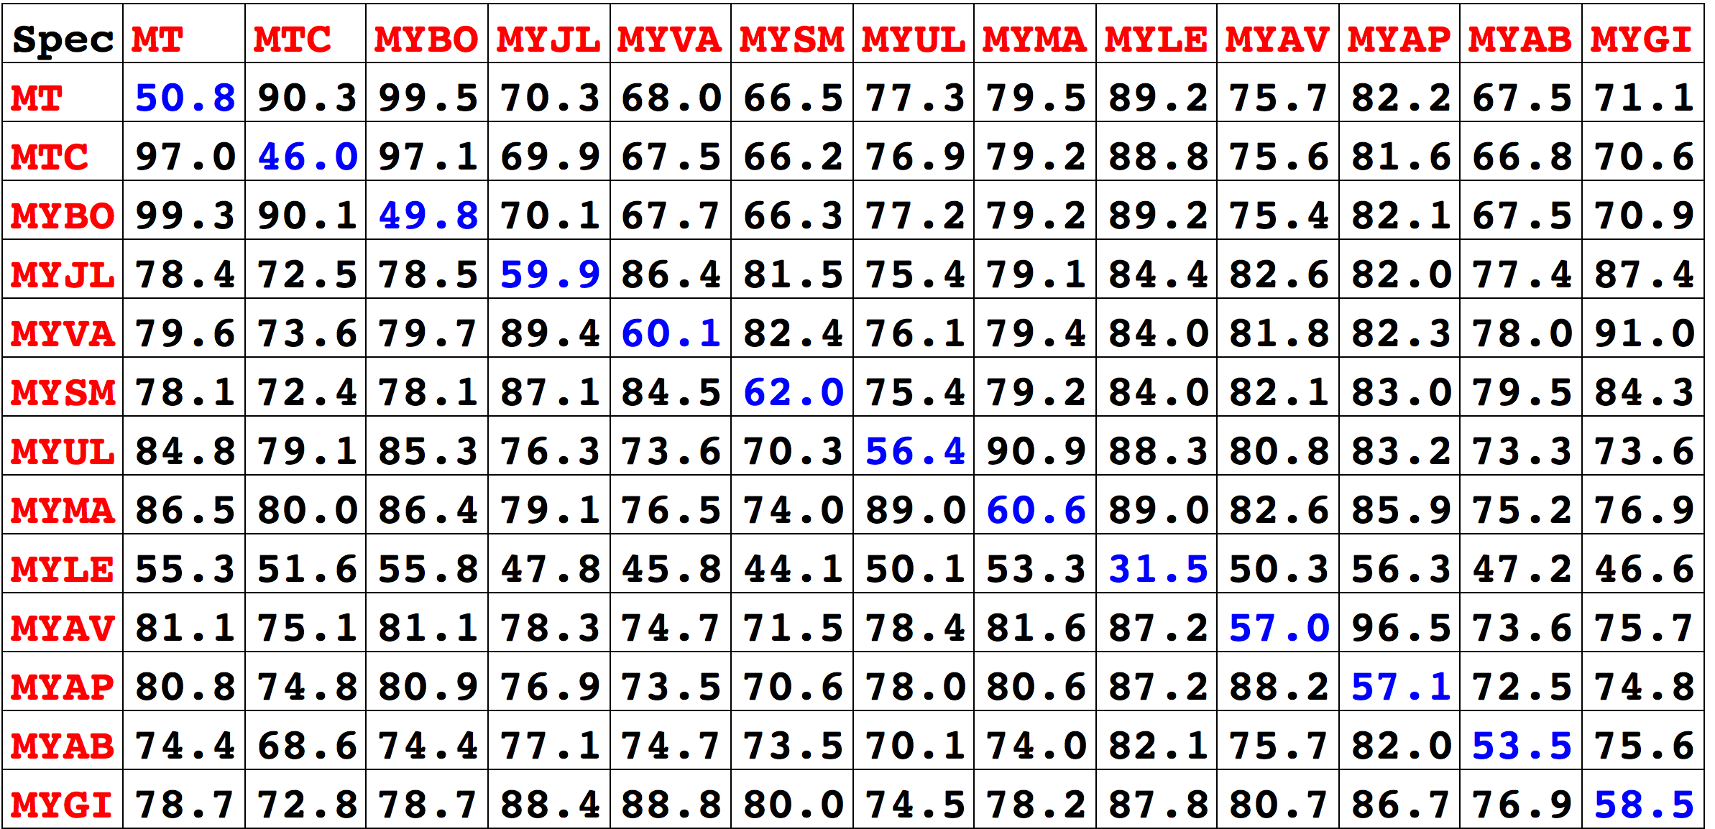
conservation
duplication

Slide 47
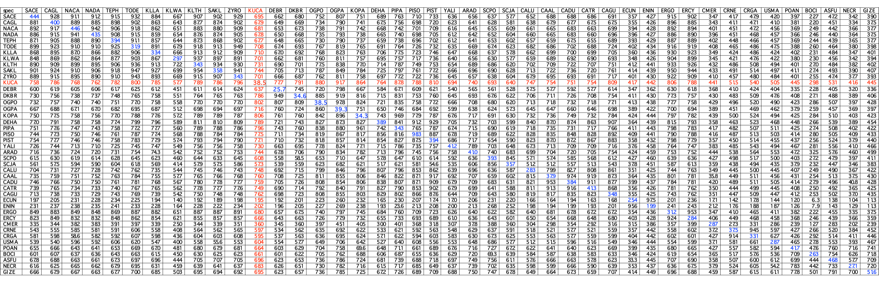
43 Yeast & Fungi species
98.3%
19.9%

Slide 48
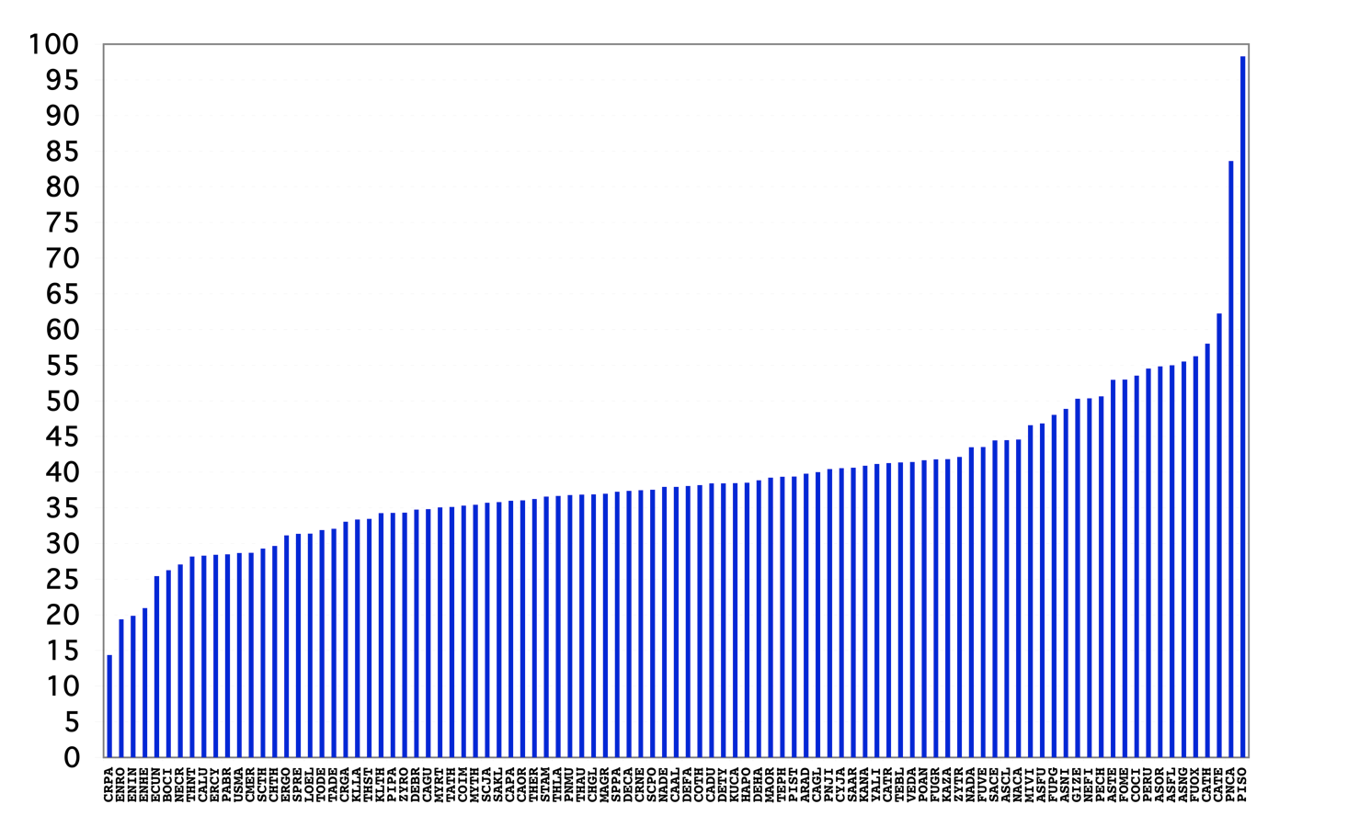
Rate of Duplication in 97 yeast and fungi species
Orfan genes
Notes:
PNCA: Pneumocystis carinii
CATE Candida tenuis

Slide 49
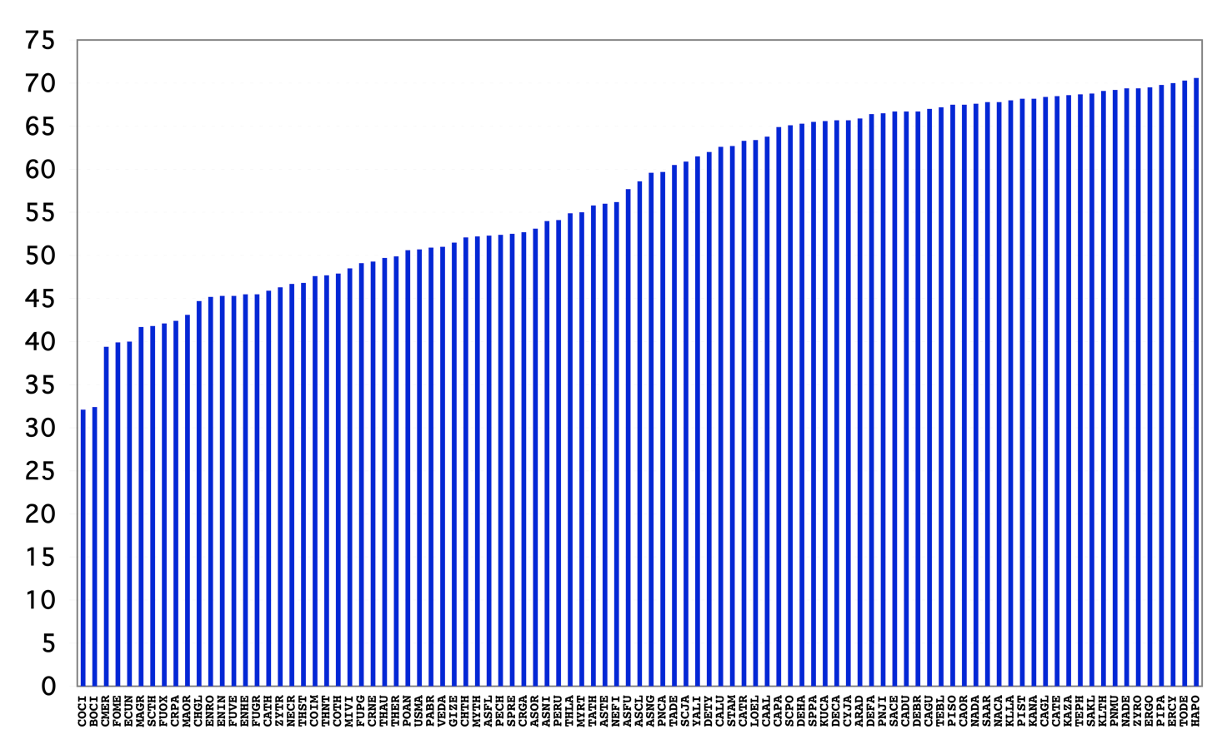
Rate of Conservation in 97 yeast and fungi species

Slide 50
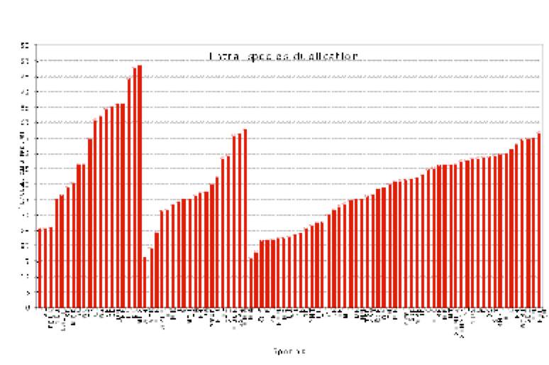
Ancestral duplication
E
A
B
mean= 52.1 30. 38.4
std= 17.8 11.7 11.2

Slide 51
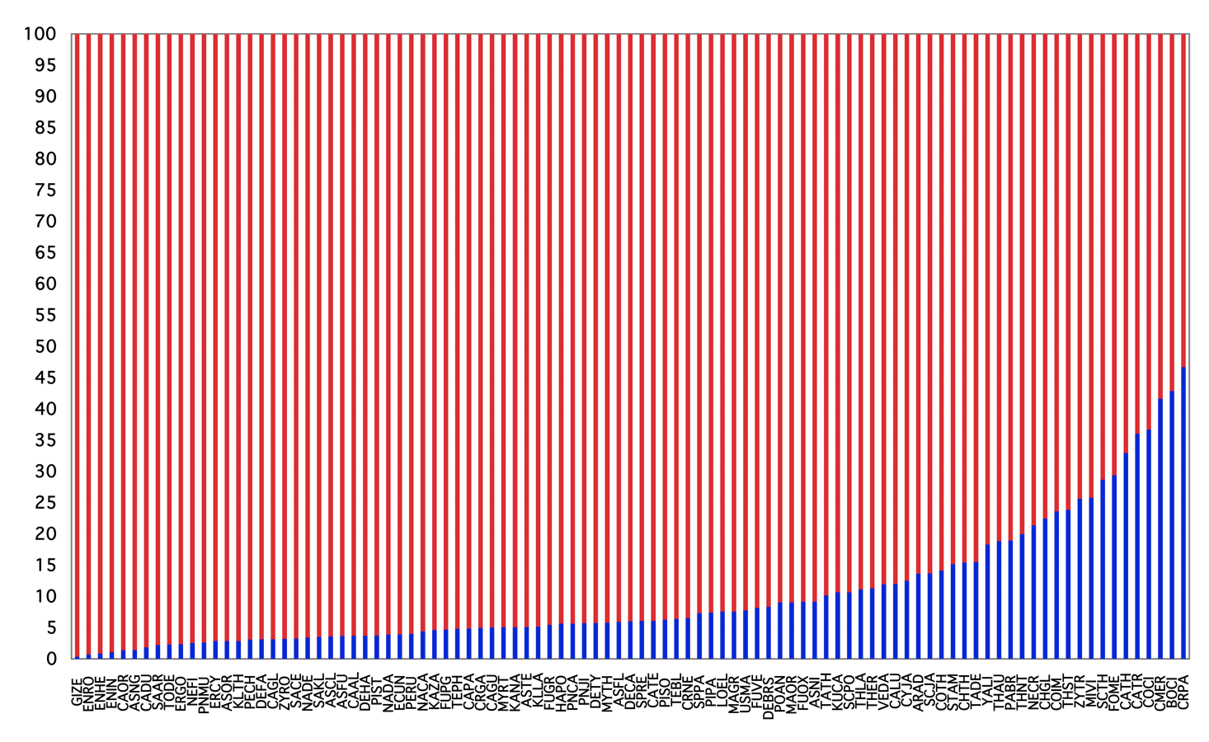
Specific and Nonspecific genes in 97 yeast and fungi species

Slide 52
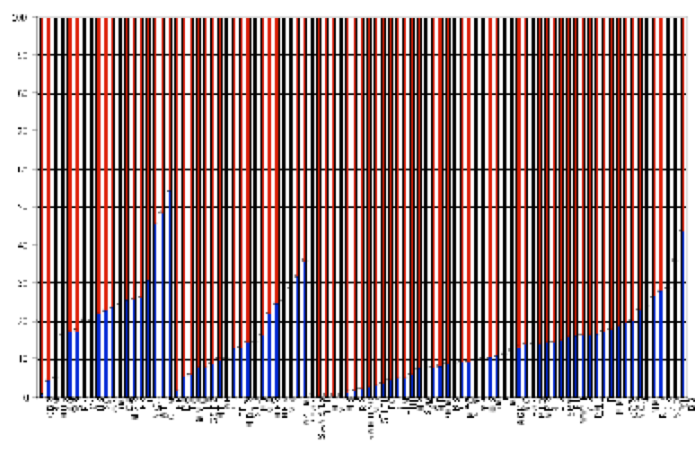
Specific and nonspecific proportions
E
A
B
mean% 76.2 84.3 87.6

Slide 53
Species specific/Orfan genes
100%
Specific members
conservation
0
different phylum
same phylum
genes

Slide 54
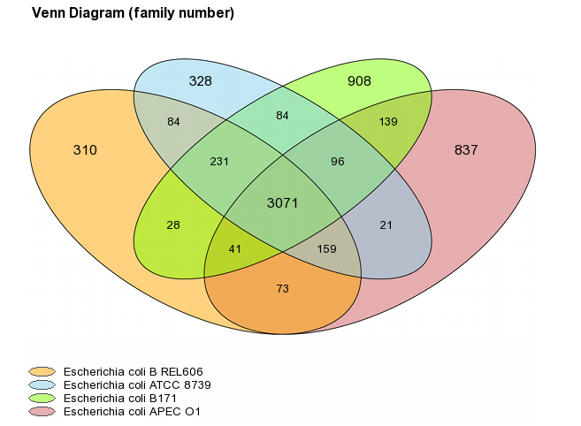
Pan-genome/Core-genome/Dispensable genome
• Pan-genome: The pan-genome is the entire gene set of all strains of a species. It includes genes present in all strains (core genome) and genes present only in some strains of a species (dispensable genome).
• Core-genome: The core genome is the set of genes present in all strains of a species.
• Dispensable genome/Accessory/variable/flexible: The dispensable genome refers to the set of genes present in at least one strain but not in all of them.

Slide 55
Example: Ratio core/pangenome of several bacterial species
Rouli et al. (2015). The bacterial pangenome as a new tool for analysing pathogenic bacteri. New Microbes New Infect. 2015;7:72-85.

Slide 56
Plan
I- Large-scale Genomes Analyses
(knowledge so far acquired)
II- Horizontal Gene Transfer
III- Orthologs, paralogs inference and clustering methods
(context - difficulties – limitations)
IV- Phylogeneomics …
V- Genomic variation

Slide 57
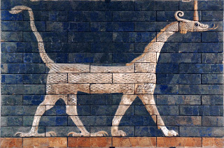
Horizontal Gene Transfer (HGT)
Not all our genes are from our ancestors - some are “foreign”
http://www.medicalnewstoday.com/articles/290835.php

Slide 58
Horizontal Gene Transfer
• A fundamental concept in biology is that heritable material, DNA, is passed from parent to offspring, a process called vertical gene transfer.
• An alternative mechanism of gene acquisition is through horizontal gene transfer (HGT), involving movement of genetic material between different species.
Leading to different evolutionary histories of genes in species involved in HGT.
• HGT has emerged as a major evolutionary process that has shaped genomes.

Slide 59
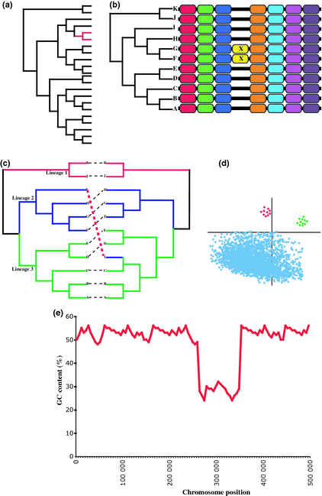
In silico detection of HGT
Fitzpatrick.DA. FEMS Microbiology Letters Volume 329, Issue 1, pages 1-8, 15 DEC 2011 DOI: 10.1111/j.1574-6968.2011.02465.x http://onlinelibrary.wiley.com/doi/10.1111/j.1574-6968.2011.02465.x/full#fml2465-fig-0001
Notes:
Detecting incidences of HGT. (a) Patchy phyletic distribution, gene of interest is not found in closely related relatives, and orthologs can only be located in distantly related species. (b) Gene of interest located in conserved synteny block and absent from closely related species. May also indicate a gene loss but similarity‐based searches can help validate if it is a potential HGT event or loss. (c) Phylogenetic inference, species gene tree on the right differs from gene tree on the left. Phylogenetic incongruence can be used to detect HGT and also determine the donor species. (d) Codon usage variation, native genes have a preferential codon usage pattern (blue dots); recently transferred genes have yet to ameliorate to their new hosts genome and still display the codon usage pattern of their cognate genome. (e) Variation in GC composition along a chromosome may indicate that alien genetic material has recently been acquired. In this case, the transferred DNA has a GC content lower than the recipient genome.

Slide 60
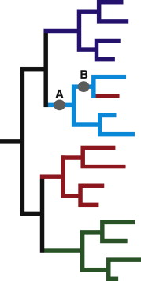
Support for Horizontal Gene Transfer between species
• Schematic phylogenetic tree showing the best possible phylogenetic support for a gene transfer hypothesis.
• The tree is a schematic presentation of a phylogeny showing four major taxonomic groups (colour coded).
Thomas et al. (2011). Fungal Biology Reviews Volume 25, Issue 2 2011 98 - 110
http://dx.doi.org/10.1016/j.fbr.2011.04.003

Slide 61
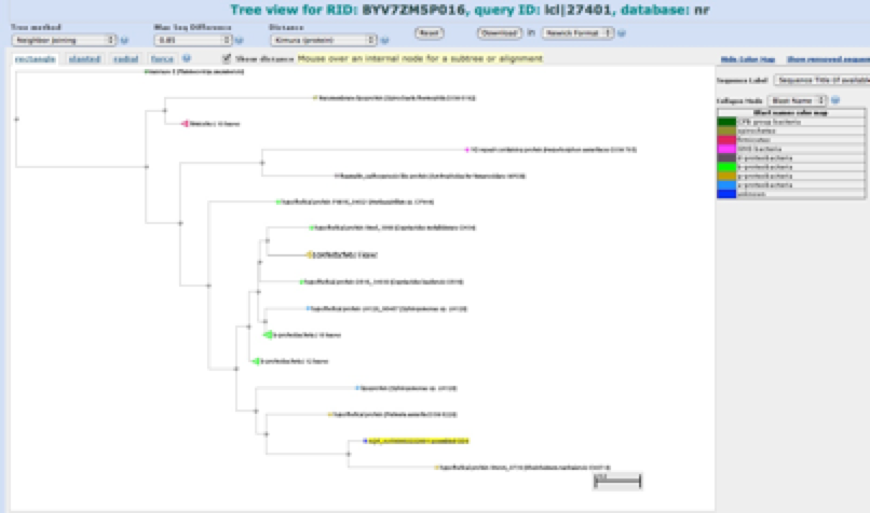

Slide 62
HGT in Prokaryotes

Slide 63
Horizontal Gene Transfer in Prokaryotes
HGT/LGT is an important mechanism of natural variation among prokaryotes.
Gene transfer has been identified as :
- a prevalent and pervasive phenomenon and
- an important source of genomic innovation in bacteria.
• Estimates suggest that on average 81% of prokaryotic genes have been involved in HGT at some point of their history.
Dagan T, Artzy-Randrup Y, Martin W. (2008). Modular networks and cumulative impact of lateral transfer in prokaryote genome evolution. Proc Natl Acad Sci USA. 105:10039–44.

Slide 64
Horizontal Gene Transfer in Prokaryotes
Dagan T, Artzy-Randrup Y, Martin W. (2008). Modular networks and cumulative impact of lateral transfer in prokaryote genome evolution. Proc Natl Acad Sci USA. 105:10039–44.

Slide 65
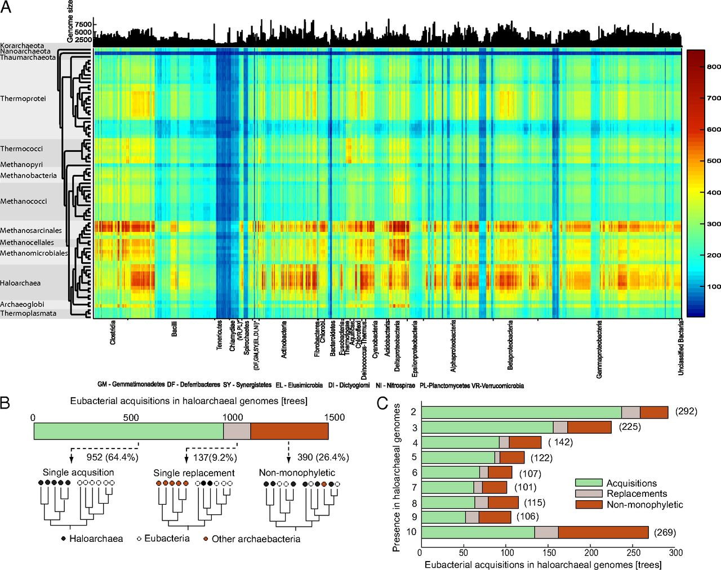
Acquisition of 1,089 eubacterial genes physiologically transformed a methanogen at the origin of Haloarchaea
(A) Number of shared genes between 1,078 bacterial genomes and 75 archaebacterial genomes.
Example
Nelson-Sathi S et al. PNAS 2012;109:20537-20542

Slide 66
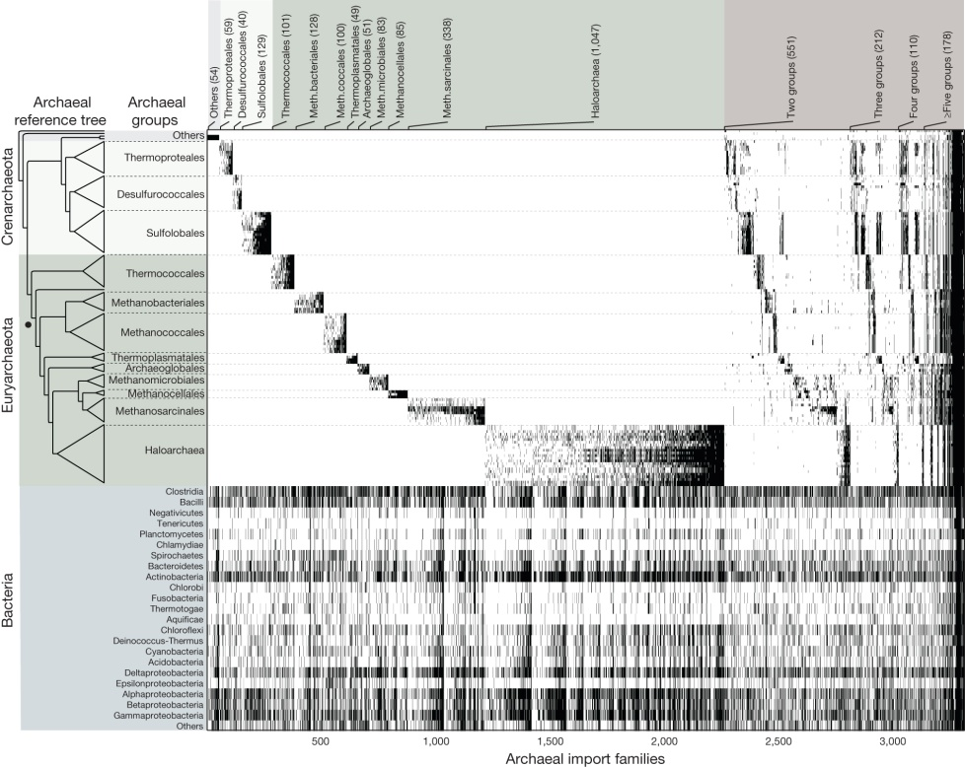

Bacterial gene acquisitions in archaeal genomes
S Nelson-Sathi et al. Nature 000, 1-4 (2014) doi:10.1038/nature13805
Origins of major archaeal clades correspond to gene acquisitions from bacteria
Notes:
Upper panel ticks indicate gene presence in the 3,315 ML trees in which archaea are monophyletic. Archaeal genomes listed as in Fig. 1. The lower panel shows the occurrence of homologues among bacterial groups. Gene identifiers including functional annotations are given in Supplementary Table 2. The number of trees containing taxa specific to each archaeal group (or groups) is indicated at the top. The Methanopyrus kandleri branch (dot) subtends all methanogens in the tree. There are 56 genes at the far right that occur in all 13 groups (fully black columns) and were probably present in the prokaryote common ancestor. Bacterial homologues of archaeal protein families were identified as described in Fig. 1 (rBBH and ｳﾊ25% global identity), yielding 8,779 archaeal families having one or more bacterial homologues. An archaeal reference tree was constructed from a weighted concatenation alignment29 of 70 archaeal single copy genes using RAxML30 program. The 70 genes used to construct the unrooted reference tree are rpsJ, rpsK, rps15p, rpsQ, rps19e, rpsB, rps28e, rpsD, rps4e, rpsE, rps7, rpsH, rpl, rpl15, rpsC, rplP, rpl18p, rplR, rplK, rplU, rl22, rpl24, rplW, rpl30P, rplC, rpl4lp, rplE, rpl7ae, rplB, rpsM, rpsH, rplF, rpsS, rpsI, rimM, gsp-3, rli, rpoE, rpoA, rpoB, dnaG, recA, drg, yyaF, gcp, hisS, map, metG, trm, pheS, pheT, rio1, ansA, flpA, gate, glyS, rplA, infB, arf1, pth, SecY, proS, rnhB, rfcL, rnz, cca, eif2A, eif5a, eif2G, and valS.

Slide 67
HGT in Eukaryotes

Slide 68
HGT in vertebrate and invertebrate genomes
• Considering 26 animal species (10 primates, 12 flies and 4 nematodes) and a further 14 vertebrates, a Genome-wide comparative and phylogenetic analyses show that HGT in animals typically gives rise to tens or hundreds of active "foreign" genes, largely concerned with metabolism.
• While fruit flies and nematodes have continued to acquire foreign genes throughout their evolution, humans and other primates have gained relatively few since their common ancestor.
• Evidence of HGT in humans is confirmed and more than 33 new examples of horizontally acquired genes are shown.
Crisp A, Boschetti C, Perry M, Tunnacliffe A, Micklem G. (2015). Expression of multiple horizontally acquired genes is a hallmark of both vertebrate and invertebrate genomes. Genome Biol.16:50.

Slide 69
Nearly 150 human genes were acquired via horizontal transfer from other species
Crisp A, Boschetti C, Perry M, Tunnacliffe A, Micklem G. (2015). Expression of multiple horizontally acquired genes is a hallmark of both vertebrate and invertebrate genomes. Genome Biol.16:50.

Slide 70
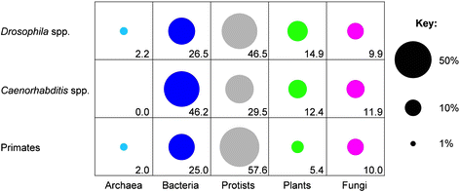
The most common donors were bacteria and protists.
Other genes came from fungi and viruses.
Crisp A, Boschetti C, Perry M, Tunnacliffe A, Micklem G. (2015). Expression of multiple horizontally acquired genes is a hallmark of both vertebrate and invertebrate genomes. Genome Biol.16:50.

Slide 71
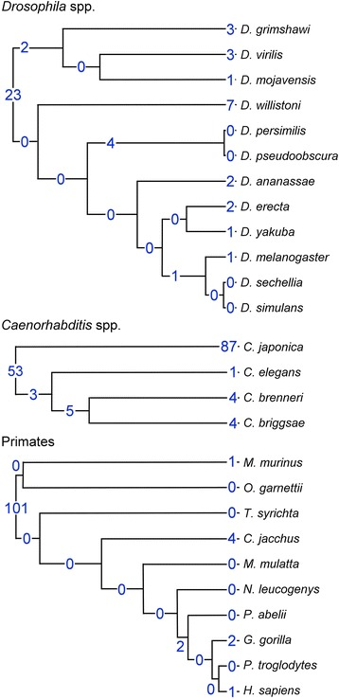
Horizontal Gene Transfer in Eukaryotes
Blue figures indicate orthologous groups mapping HGT events
Crisp A, Boschetti C, Perry M, Tunnacliffe A, Micklem G. (2015).
Expression of multiple horizontally acquired genes is a hallmark of both vertebrate and invertebrate genomes. Genome Biol.16:50.

Slide 72
Horizontal Gene Transfer in Fungi
Recently discovered also among Fungi.
The role of gene transfer in microbial eukaryotes seems to be of a reduced magnitude but in some cases can drive important evolutionary innovations, such as new functions that underpin the colonization of different niches.

Slide 73
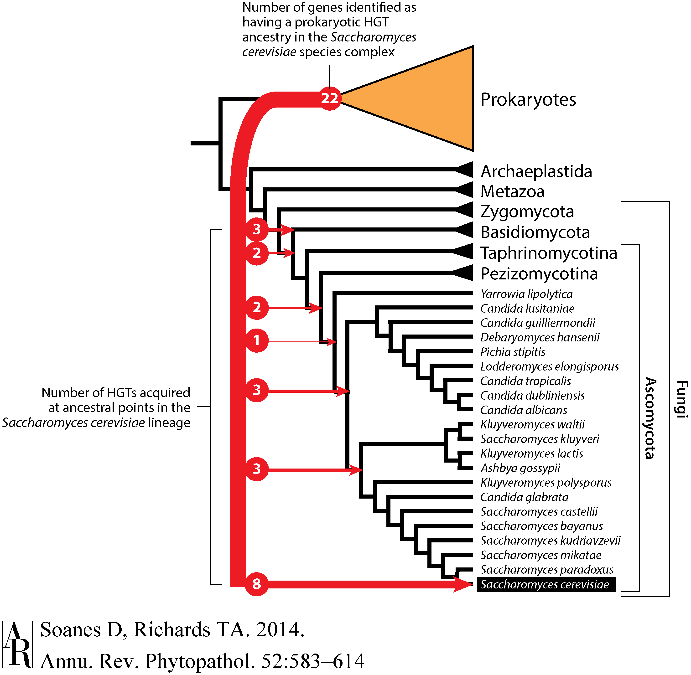
22 ascomycetes genes identified as having a Prokaryotic origin
Annual Reviews
Notes:
Figure 2 Schematic phylogeny demonstrating ancestry of 22 prokaryotic-derived horizontal gene transfers (HGTs) present in Saccharomyces cerevisiae strains. Red arrows point to the likely points of acquisition of these HGTs, given available taxon sampling and accounting for secondary loss. Increased genome sampling may demonstrate deeper ancestries for these HGTs. The tree topologies are based on published multigene phylogenies (51). The figure is adapted from Reference 147.

Slide 74
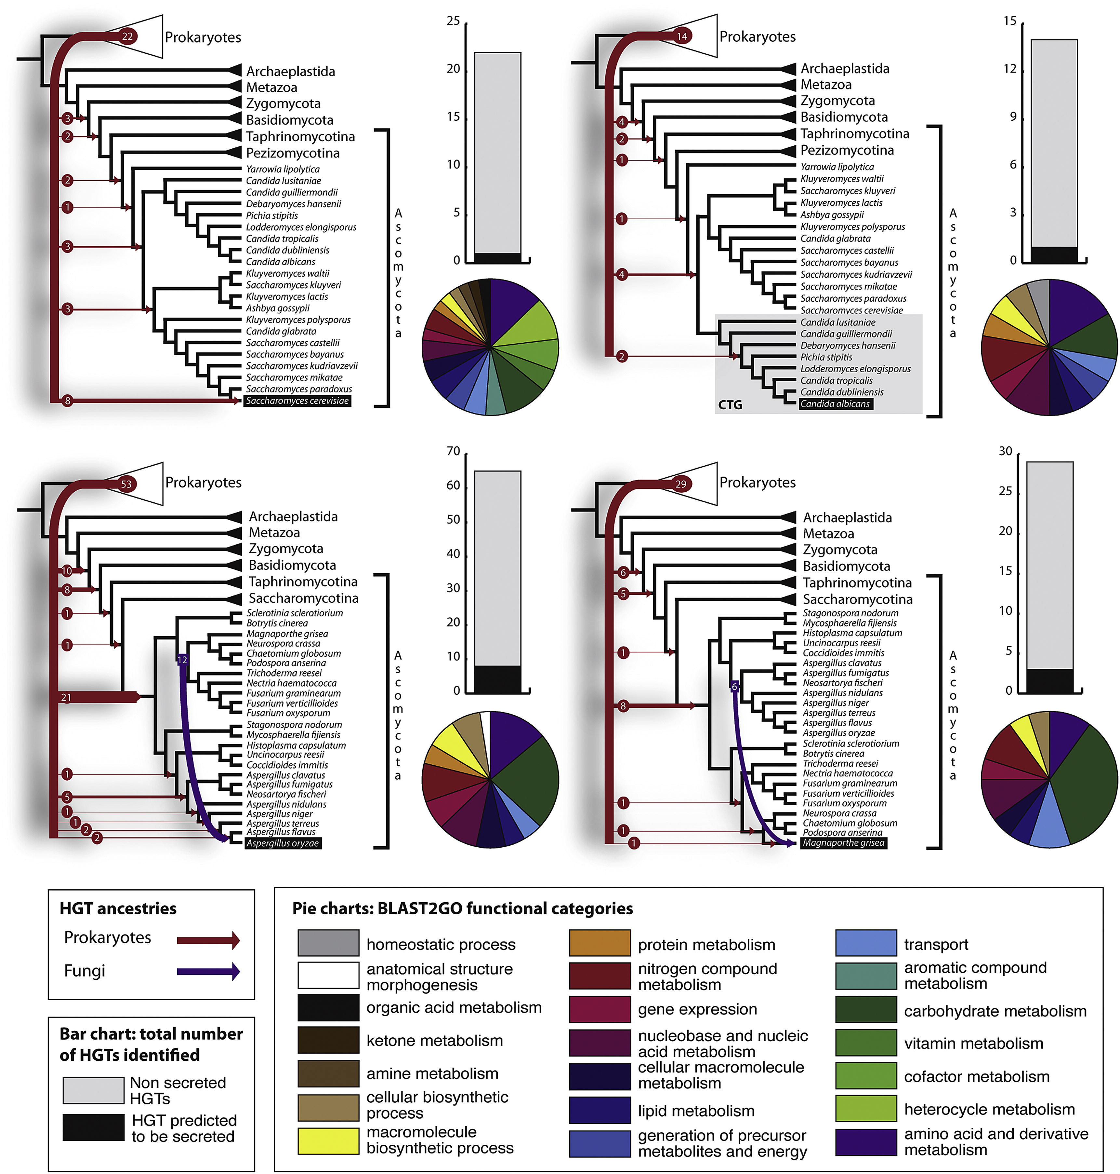
Gene transfer into the fungi
Richards TA et al. (2011). Fungal Biology Reviews Volume 25, Issue 2 2011 98 - 110.

Slide 75
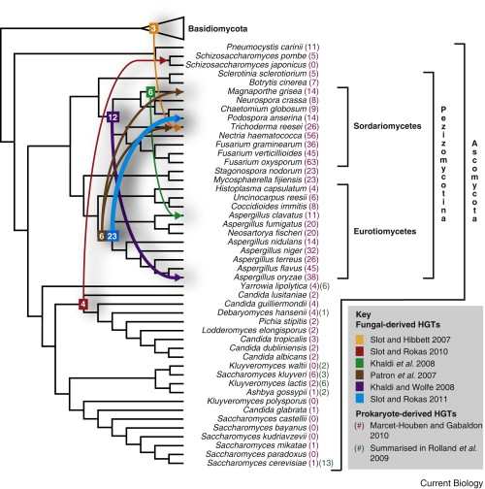
Fungal-derived horizontal gene transfer into the Ascomycota
Number of acquired prokariotic-derived HGT genes
Thomas A. Richards; Current Biology. Volume 21, Issue 4, 22 February 2011, Pages R166-R168.

Slide 76
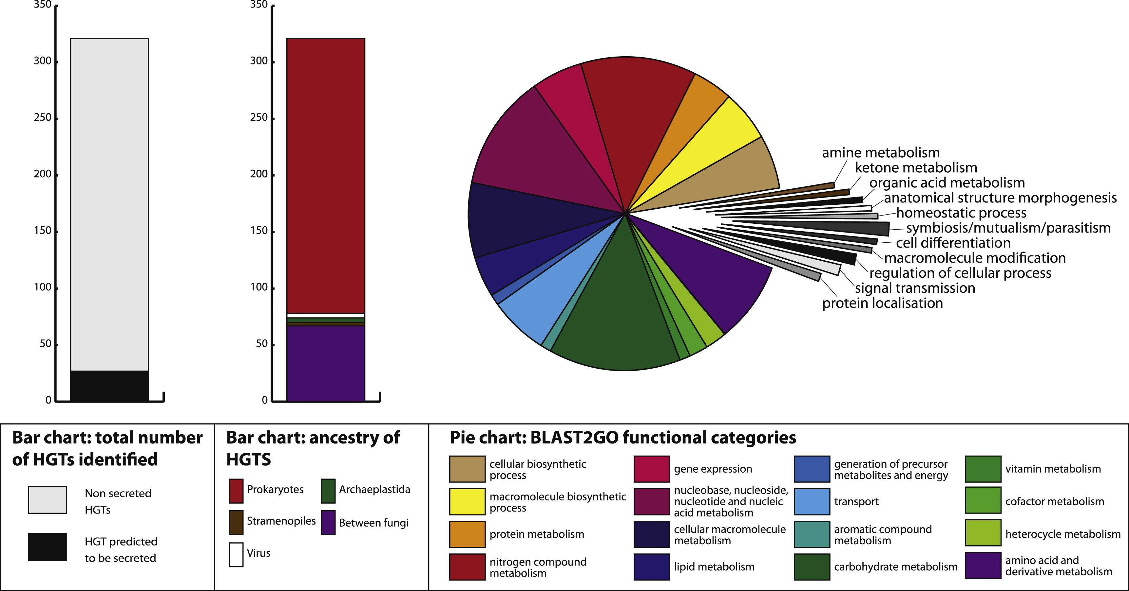
Ancestry of Horizontal Gene Transfer
323 transfers into the fungi
Richards TA et al. (2011). Fungal Biology Reviews Volume 25, Issue 2 2011 98 - 110
http://dx.doi.org/10.1016/j.fbr.2011.04.003

Slide 77
HGT: Eukaryote towards Legionella
• Genome sequencing of L. pneumophila strains has revealed an abundance of eukaryotic-like proteins (ELPs).
• Thirty- four (34) new ELPs were identified, based on a higher similarity to eukaryotic proteins than to bacterial ones.
Lurie-Weinberger, M.N., et al., The origins of eukaryotic-like proteins in Legionella pneumophila. Int. J. Med. Microbiol. (2010), doi:10.1016/j.ijmm.2010.04.016

Slide 78
HGT databases
• HGT-DB: http://genomes.urv.es/HGT-DB/
Originally based on 88 prokaryotic species.
Garcia-Vallve S, Guzman E, Montero MA, Romeu A. (2003). HGT-DB: a database of putative horizontally transferred genes in prokaryotic complete genomes. Nucleic Acids Res. 2003 Jan 1;31(1):187-9.

Slide 79
HGT databases
• HGTree in prokaryotes: http://hgtree.snu.ac.kr
Jeong H, et al. (2016). HGTree: database of horizontally transferred genes determined by tree reconciliation. Nucl. Acids Res. 2016 44: D610-D619 http://nar.oxfordjournals.org/content/44/D1/D610.abstract?etoc

Slide 80
Gene fusion, fission Domains Shuffling

Slide 81
Gene fusion, fission Domains Shuffling
Gene fusion
Gene fission
Domains shuffling
homology inference Problem
Different Ancestral origins
=>

Slide 82
Plan
I- Large-scale Genomes Analyses
(knowledge so far acquired)
II- Horizontal Gene Transfer
III- Orthologs, paralogs inference and clustering methods
(context - difficulties – limitations)
IV- Phylogeneomics …
V- Genomic variation

Slide 83
Speciation – Duplication

Slide 84
Speciation - Duplication
S
g
Duplication
• Duplication
Time
• Speciation
g1
g2
Speciation
• Homologs
g2b
• Inparalogs
Duplication
g2a
• Orthologs
g1b
g1a
g2₁b
g2₂b
• Outparalogs
outparalogs
inparalogs
outparalogs
• Loss of genes
A
orthologs
B
Predict these events by comparing genomes?

Slide 85
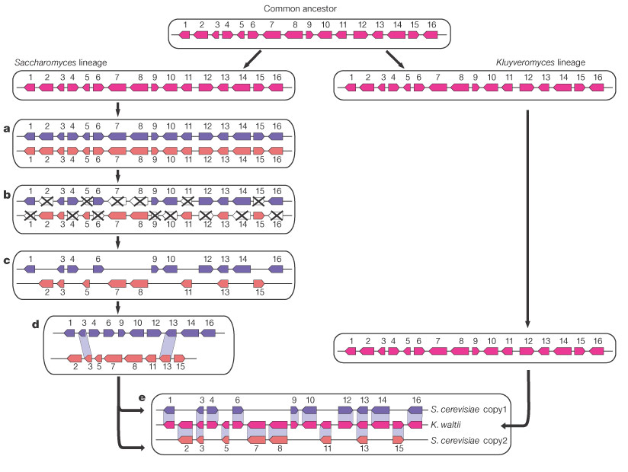
Duplication
Speciation
Deletion
Actual content of the 2 copies
Reconstruction of the ancestral organization
Kellis et al. 2004. Nature, 428:617-24.

Slide 86
Ancestral conservation
• Inferring Orthologs between pairs of species
• Determining clusters of orthologs between multiple species
• Determination of protein conservation profiles;

Slide 87
Orthologs Inference:
Context, Methods and Limitations
Tekaia F. Inferring Orthologs: Open Questions and Perspectives (Review). Genomics Insights 2016:9 17–28 doi:10.4137/GEI.S37925.

Slide 88
Inferring Orthologs/Paralogs and classification
Why is it important?
Orthologs detection is of fundamental importance in the:
Reconstruction of the evolution of species and their genomes (Phylogenomics);
- Evolutionary studies of biological systems;
- Annotation of newly sequenced organisms;
- Functional genomics (transfer of functional annotation predicted on “orthology-function conjecture”);
- Gene organization in a given species.
Accurate determination of evolutionary relationships between orthologous gene families is of utmost importance for such goals.

Slide 89
Definitions
• Orthologs are homologous genes resulting from a speciation event
(Fitch, 1970)
• Paralogs are homologous genes resulting from a duplication event
Fitch WM. Homology a personal view on some of the problems.
Trends Genet. 2000;16:227-31. Review.

Slide 90
Orthologs / Paralogs
How to detect orthologous genes?
- easy way: Best Reciprocal Hit (RBH)
1a
1b
2.1a
2.1b
2.2a
2.2b
3a
3b
Organism A
Organism B
2.1a
2.1b
Best Reciprocal Hits

Slide 91
Orthologs / Paralogs
- more rigorous: make a phylogenetic tree of the gene family
1a
1b
2.1a
2.1b
2.2a
2.2b
3a
3b
- more rigorous: look at synteny conservation
1b
2.1b
3b
1a
2a
3a
Organism B
Organism A
4b
2.2b
5b
--> In fact inferring orthology is much more complicated particularly when considering more than 2 genomes!

Slide 92
Orthologs / Paralogs
Complex combinations of lineage-specific gene duplications, losses, domains fusion, non-uniform evolutionary rates and horizontal gene transfer events often give rise to intricate evolutionary scenarios and complicated relationships when considering more than a pair of genes (i.e when multiple paralogs and/or multiple species are involved)
Koonin EV. 2005. Annu Rev Genet. 39:309-38.
Gabaldon T, Koonin EV. 2013. Nat Rev Genet. 14:360-6.

Slide 93
Difficulties with Orthology inference:
• HGT: genes with different evolutionary histories not sharing ancestry with other genes in the species
• Proteins with multiple domains involving multiple origins (difficulty with the homology definition)
(Fusion, fission, shuffling)
Tekaia F. Inferring Orthologs: Open Questions and Perspectives (Review). Genomics Insights 2016:9 17–28 doi:10.4137/GEI.S37925.

Slide 94
Loss of genes : Example of an orthology misleading situation
g₀
g_{1a}
g_{1b}
g_{2a}
g_{2b}
g₃
X
X
g
g₀
g₁
g₂
g₃
S₂
g₀
g₁
g₂
g₃
X
S
S
S₁
Gd
Sp + Gd in S₂
We assume that gene g₁ (in S₁) and genes g_{2a} and g_{2b} (in S₂) are lost, similarity and phylogenetic methods for orthology detection will assign erroneously orthology to g₂, g_{1a} and g_{1b}. Indeed these are not orthologous, because g₂, g_{1a} and g_{1b} do not result from the same ancestral gene after the speciation event.
In this case solely the environment conservation, will help in detecting the gene duplication and loss event, and hypothesise their non-orthology.

Slide 95
With the increasing number of sequenced genomes and their comparisons, the detection of orthologs is crucial for reliable functional annotation and evolutionary analyses of genes and species. Yet the dynamic remodelling of genome content through gain, loss, transfer of genes, whole and segmental genome duplication hinders reliable orthology detection. Moreover the lack of direct functional evidence and the questionable quality of some available genome sequences and annotations present additional difficulties to assess orthology.
We review existing methods and their potential accuracy in the high throughput era of genome sequencing and we anticipate open questions in terms of methodology, reliability and computation. Appropriate taxon sampling together with combination of methods based on similarity, phylogeny, synteny and evolutionary knowledge that may help detecting speciation events appear to be the most accurate strategy.

Slide 96
With he exponential increase of available completely sequenced genomes and their studies [11,12] many methods have been introduced for genes and species trees construction taking into account these evolutionary processes [10,13,14].
In this context the proper identification of orthologous genes is a major challenge because accumulation of evolutionary dynamic events tend to blur the recognition of true orthologs among a set of homologs [15-18]. Most methods for large-scale detection of orthologs are based on homology as inferred by sequence similarity. It is generally admitted that large-scale orthology assignment is a non-trivial task. A large number of methods were elaborated to solve this problem, with various advantages and limitations [see references in 17,19,20]. However, in general such methods suffer from a common limitation, relevant to the difficulties in constructing orthologous classes in the presence of paralogs. More specifically, for distantly related species, assessing orthology can become very difficult typically because of low similarity between protein sequences and the likely increase of gene-birth and death [15].
In contrast for closely related species, synteny conservation provides useful information to identify conserved chromosomal segments, in which orthologous genes can more steadily be searched for.

Slide 97
Sequence similarity is almost always the only criterion available to indicate homology. This criterion introduces a limit to detection of homology as sequences may diverge beyond statistical recognition when evolutionary distances between compared species increase. Additional complications include the dynamics of gene duplication, loss, transfer or fusion/fission occurring during genome evolution.

Slide 98
The dynamic of duplication/loss during evolution
Complications

Slide 99
• in-paralogs are paralogs issued from duplication posterior to speciation
• out-paralogs are paralogs issued from duplication prior to speciation
Sonnhammer EL, Koonin EV. Orthology, paralogy and proposed classification for paralog subtypes. Trends Genet. 2002; 18:619-620.

Slide 100
As a consequence:
• Out-paralogs are also sometimes referred to as pseudo-orthologs
• In-paralogs issued from duplication in one lineage are themselves co-orthologs to the only copy present in another lineage in which no duplication took place.
Koonin EV. Orthologs, paralogs, and evolutionary genomics.
Annu Rev Genet. 2005; 39:309-38. Review.

Slide 101
Specific situations are generated by events of WGD and by HGT:
• Ohnologs are pairs of in-paralogs left after a WGD
• Xenologs are genes that appear falsely as orthologs because at least one of the pair is acquired via HGT from another species

Slide 102
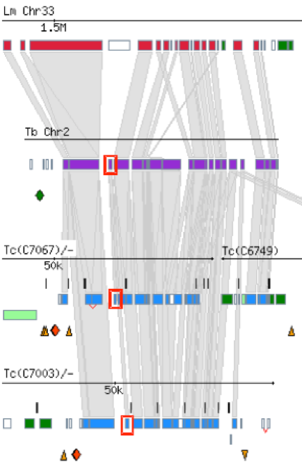
Microsynteny break (gene replacement)
Sedoheptulose bisphosphatase
different gene in L. major
SBPase only
in T. cruzi and T. brucei
Possible HGT
Peter Myler

Slide 103
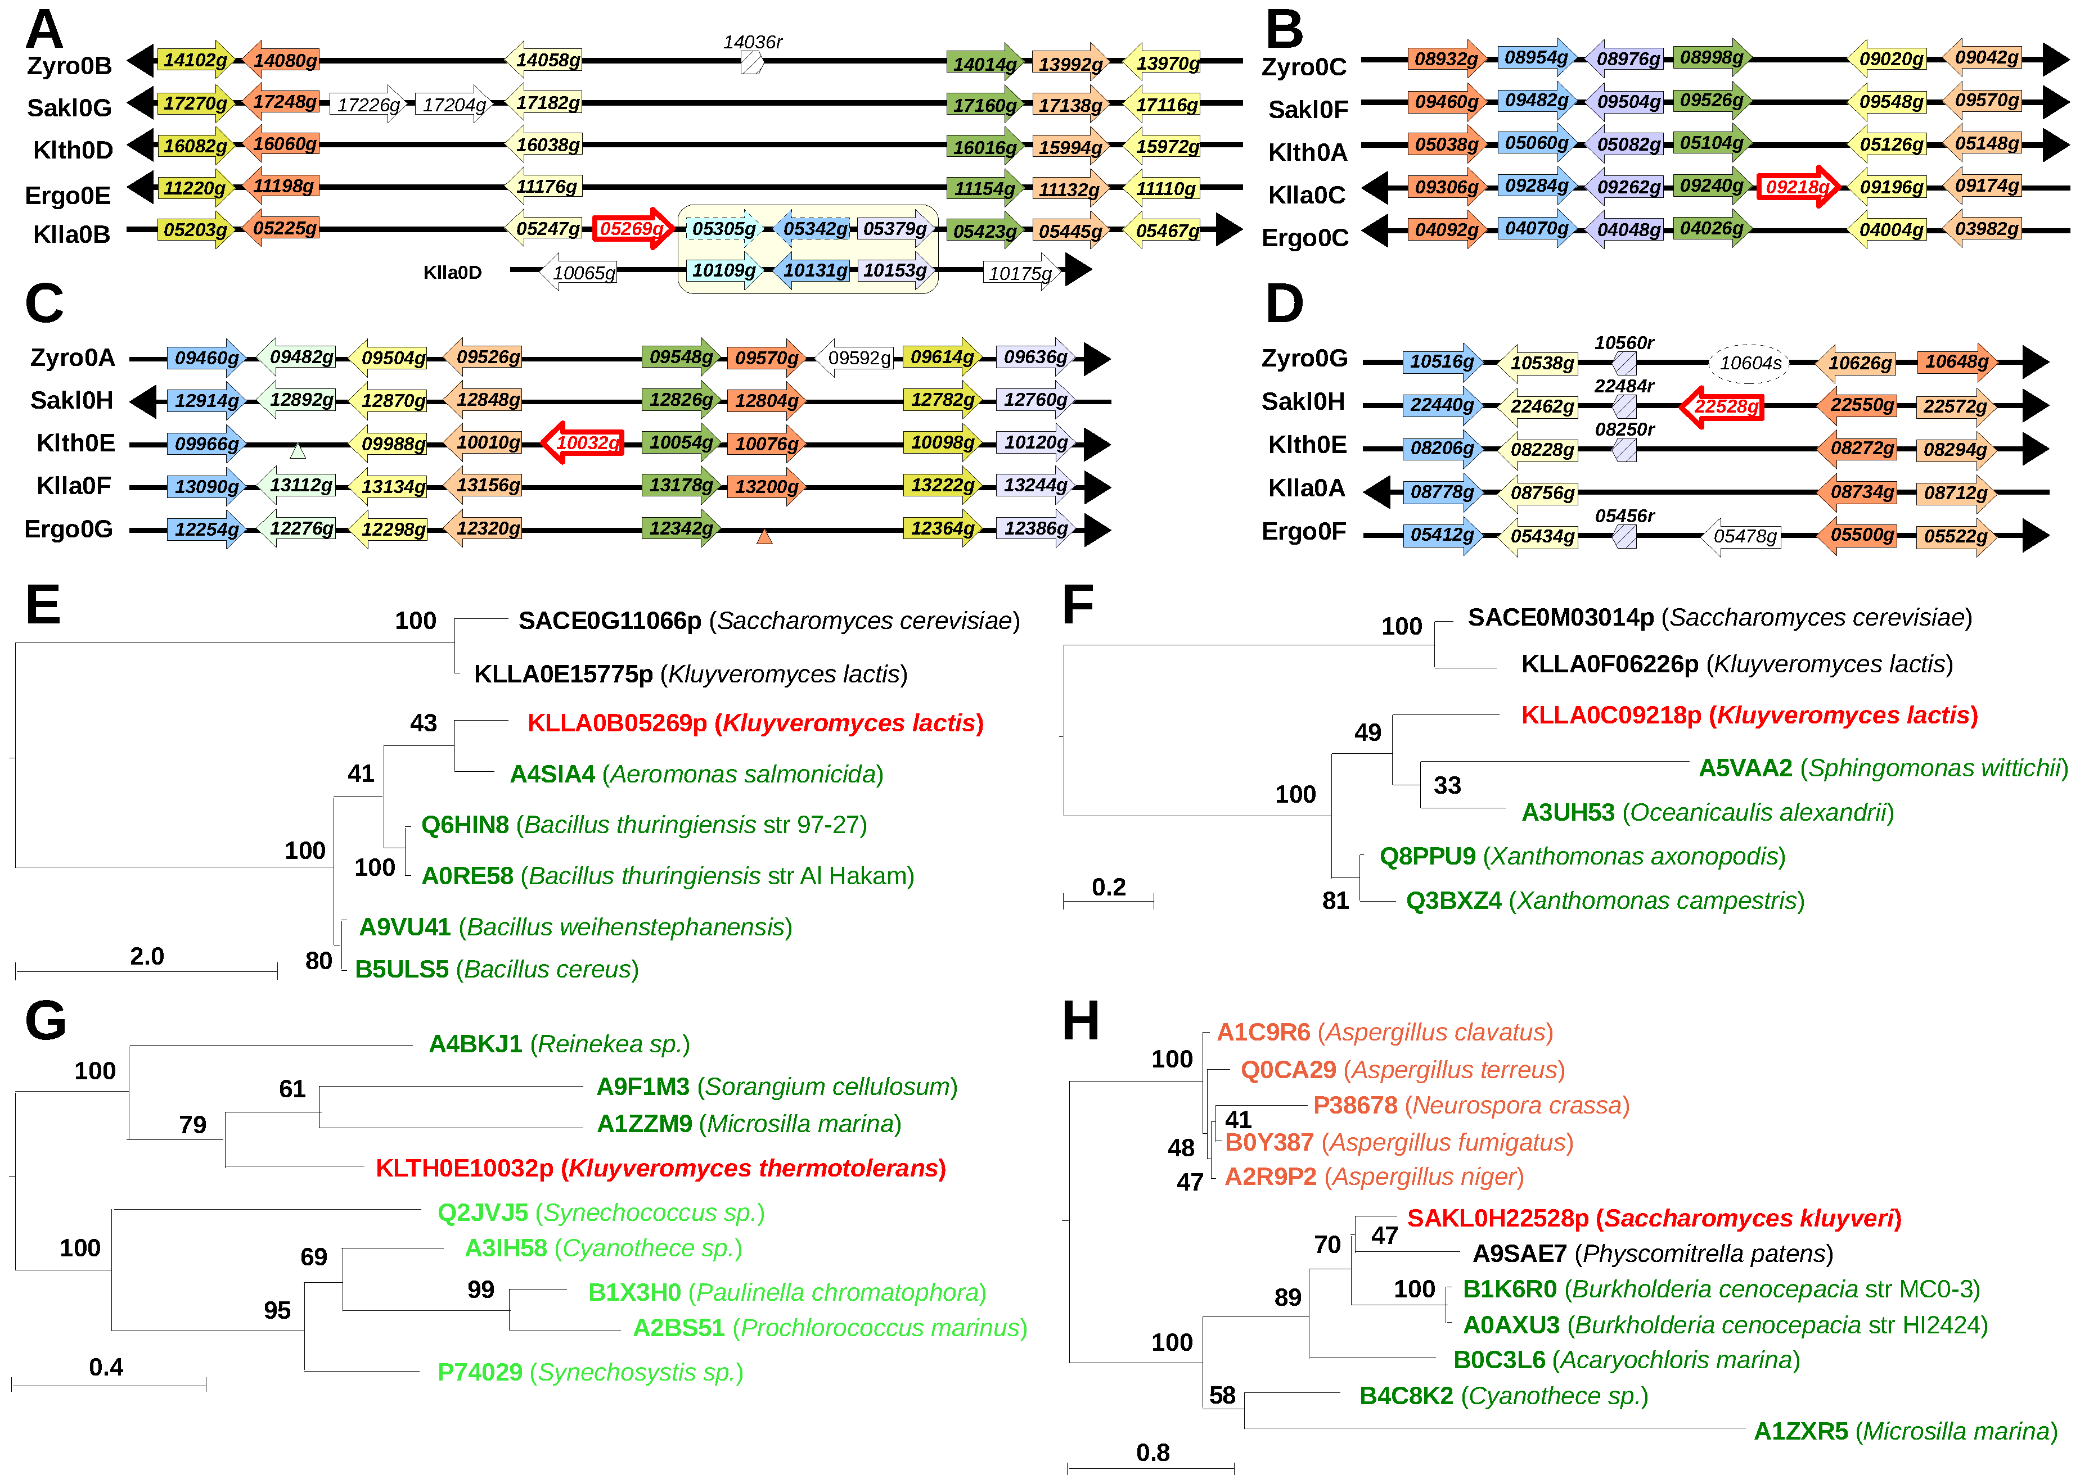
Rolland T, Neuveglise C, Sacerdot C, Dujon B (2009) Insertion of Horizontally Transferred Genes within Conserved Syntenic Regions of Yeast Genomes. PLoS ONE 4(8): e6515.

Slide 104
In spite of the above difficulties, genome-wide statistical trends show that orthologs are the most similar genes in different species, in terms of sequence, structure and function.

Slide 105
Orthologs inference Methods

Slide 106
Methods for orthology detection
Two main approaches to determine orthologous gene classes, based either on:
• Sequence similarity
or on
• Phylogeny

Slide 107
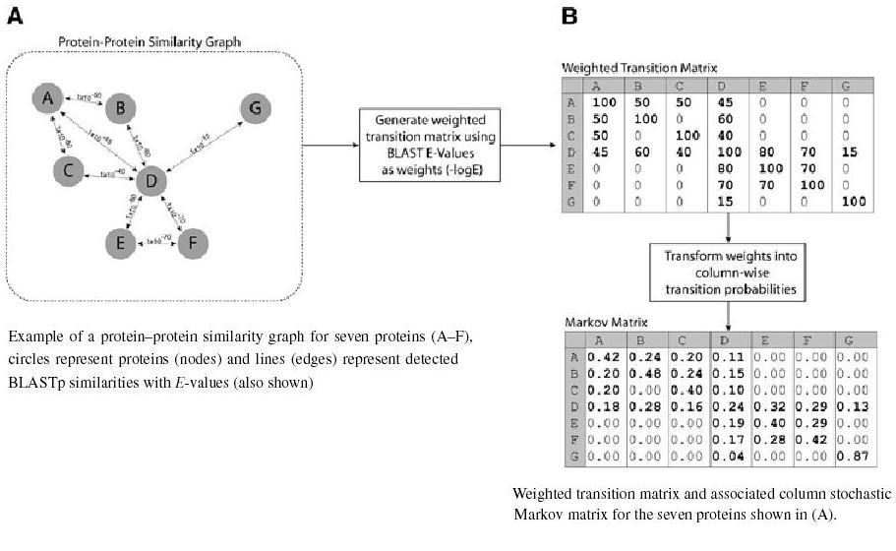
Clustering Methods
mcl: The Markov Cluster Algorithm
http://micans.org/mcl/ (Stijn Van Dongen)

Slide 108
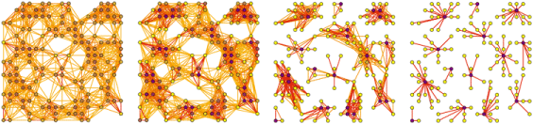
Inflation index
MCL animation:
http://micans.org/mcl/ani/mcl-animation.html
Notes:
108

Slide 109
Other clustering Methods
Known clustering methods:
Single-linkage, k-means, partitions,…

Slide 110
Partition - mcl clustering

Slide 111
Partition
•
•
•
P4.2
•
•
•
•
•
•
•
•
•
•
P7.1
•
•
•
•
•
•
•
•
•
•
•
•
•
•
Set of similar proteins (same colour)
•
•
P4.1
•

Slide 112
mcl clustering
C4.1
•
•
•
•
•
C3.2
C1.1
•
•
•
•
•
•
•
•
•
•
•
•
•
•
•
•
•
•
•
•
•
C1.2
•
C3.1
C1.3
•
C2.1
•
•
C2.1

Slide 113
Partition/mcl clustering
P7.1.C4.1
•
•
•
•
•
P4.2.C3.2
•
•
•
•
•
•
•
•
P4.2.C1.1
•
•
•
•
•
•
•
•
•
•
•
•
•
P4.1.C1.2
P7.1.C3.1
•
P4.1.C1.3
•
•
•
P4.1.C2.1
P4.1.C2.1

Slide 114
Similarity based Approaches
• Rely on genome comparisons and clustering of highly similar genes to identify orthologous groups

Slide 115
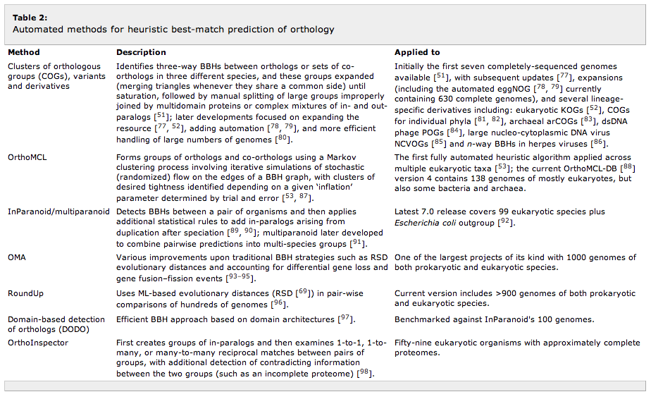
Similarity based Approaches
Kristensen et al. 2011. BRIEFINGS IN BIOINFORMATICS. VOL 12. NO 5. 379-391

Slide 116
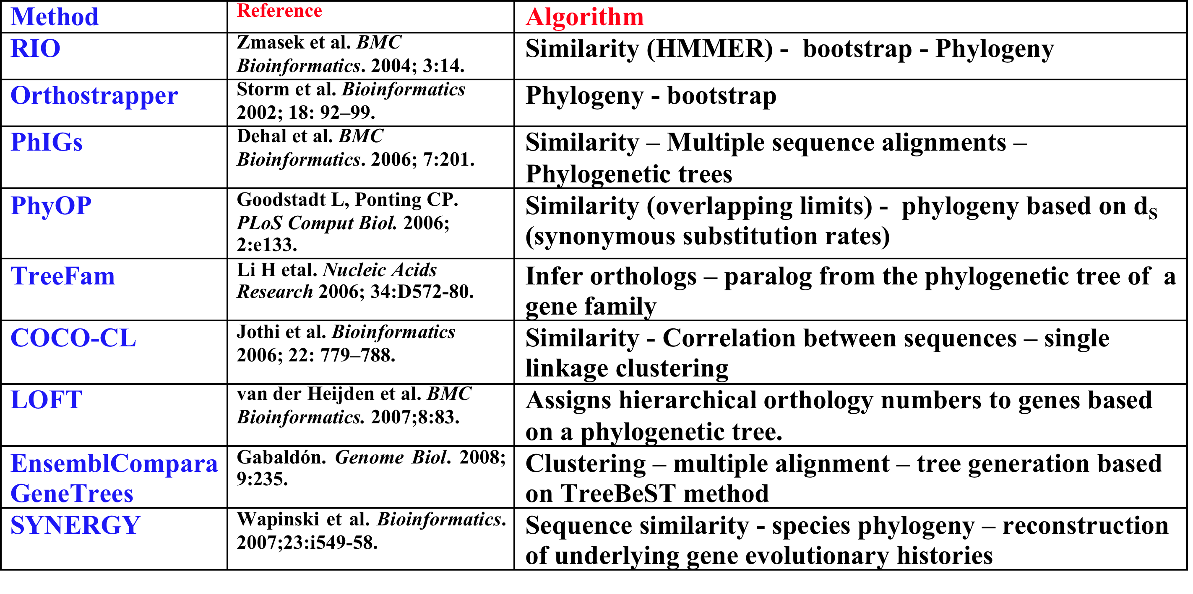
Phylogeny-based approaches
use candidate gene families determined by similarity and then rely on the reconciliation of the phylogeny of these genes with their corresponding species phylogeny to determine the subset of orthologs

Slide 117
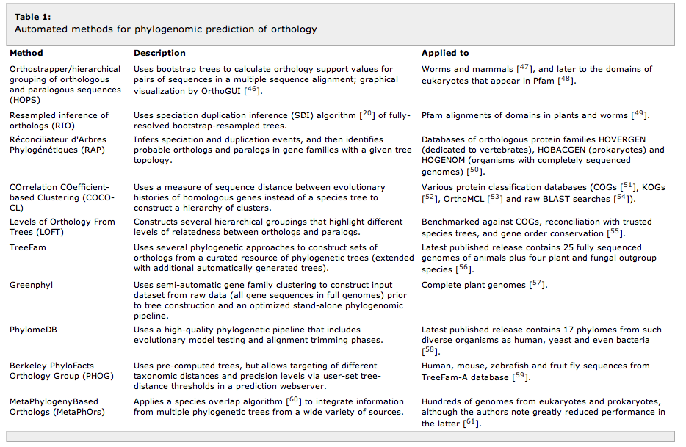
Phylogenomy based methods
Kristensen et al. 2011. BRIEFINGS IN BIOINFORMATICS. VOL 12. NO 5. 379-391

Slide 118
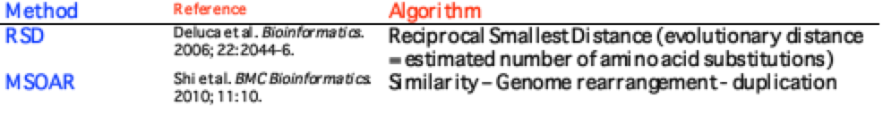
Other combination of Methods

Slide 119
• Phylogeny based methods fit best for small sets of genomes
• Similarity based methods fit for large genome-data sets

Slide 120
Othology Databases
• COGs (Clusters of Orthologous Groups): http://www.ncbi.nlm.nih.gov/COG/
• eggNOG (evolutionary genealogy of genes: Non-supervised Orthologous Groups): http://eggnog.embl.de/version_3.0/
• OMA (Orthologous Matrix): http://omabrowser.org/cgi-bin/gateway.pl
• OrthoMCL: http://orthomcl.org/orthomcl/
http://questfororthologs.org/orthology_databases

Slide 121
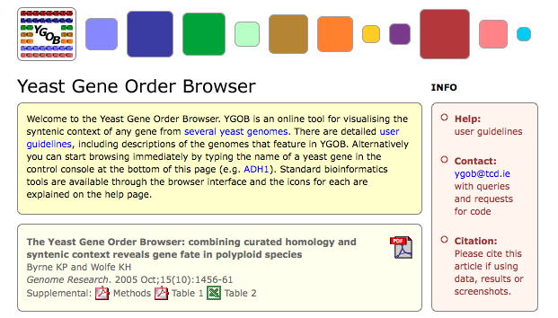
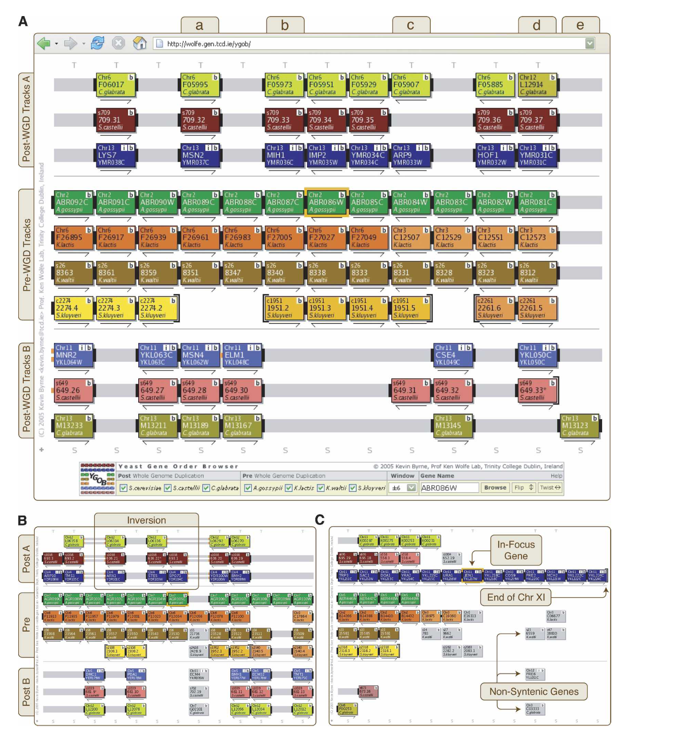
121

Slide 122
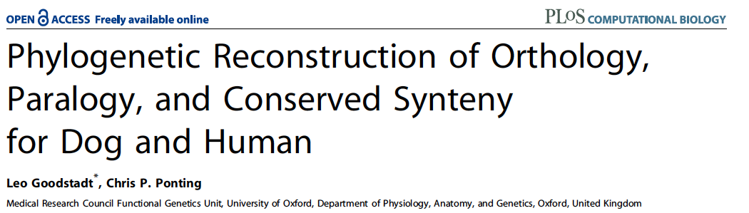
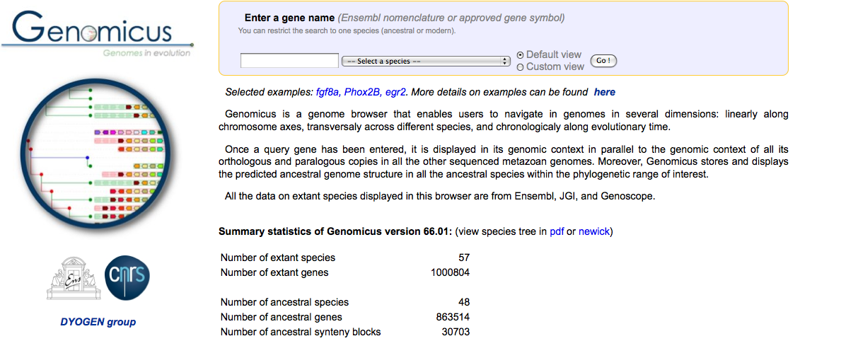

Slide 123
SuperPartitions (SPO): detection and classification of Orthologs
Tekaia F & Yeramian E (2012). Gene; 492:199-211.

Slide 124
Set of Predicted proteomes
Each proteome
Each pair of proteomes
Intra-species blastp comparisons (blosum62, -F “mS” -s T)
Pair-wise Inter-species blastp comparisons
(blosum62, -F “m S” -s T)
Set of intra-species Reciprocal Significant Hit proteins
Set of RBH proteins between all pairs of species
Partition clustering: Pn.m
mcl clustering: Cp.q
Partition P_{RBH}l.o
Each protein is assigned to an intra-species class:
Pn.m.Cp.q or singleton
Each protein is assigned to a given P_{RBH}l.o
P_{RBH}l.o containing proteins in the same intra-species mcl class Pn.m.Cp.q are merged into a SuperPartitions: SPOr.s
P_{RBH}l.o not including proteins in the same intra-species class denoted SPOr.s
SPO Conservation profiles of type n:m
SPO Conservation profiles of type 1:1
Detection of In-paralogs
Each protein described by: RBH class, paralogous class/singleton, in/out paralog tag (if any), SPO and corresponding conservation profile
Tekaia F & Yeramian E (2012).Superpartitions: Detection and classification of orthologs. Gene; 492:199-211.

Slide 125
SuperPartitions of Orthologs
S₁
S₅
S₂
S₄
S₃
s21
s11
s21
s31
s41
s51
P_{RBH}5.1
s12
s52
s42
P_{RBH}3.1
s22
s22
s32
P_{RBH}2.1
s23
s11
s31
s11
s21
s31
s41
s51
s12
s32
s12
s22
s32
s42
s52
s13
SPO10.1
s51
s41
s52
s42
s53
Tekaia F & Yeramian E (2012).Superpartitions: Detection and classification of orthologs. Gene; 492:199-211.
s54

Slide 126
SPO Conservation/Phylogenetic Profile
In 8 Aspergilli species
SPO8.1 ASFL-ASOR-ASTE-ASNG-NEFI-ASFU-ASCL-ASNI
SPO8.1 1 1 1 1 1 1 1 1
SPO4.2 ....-ASOR-....-ASNG-NEFI-ASFU-....-....
SPO4.2 0 1 0 1 1 1 0 0
SPO15.3 ASFL-ASOR-ASTE-....-NEFI-ASFU-ASCL-ASNI
SPO15.3 1 1 1 0 4 3 3 2
Tekaia F & Yeramian E (2012). Superpartitions:
Detection and classification of orthologs. Gene; 492:199-211.
Notes:
126

Slide 127
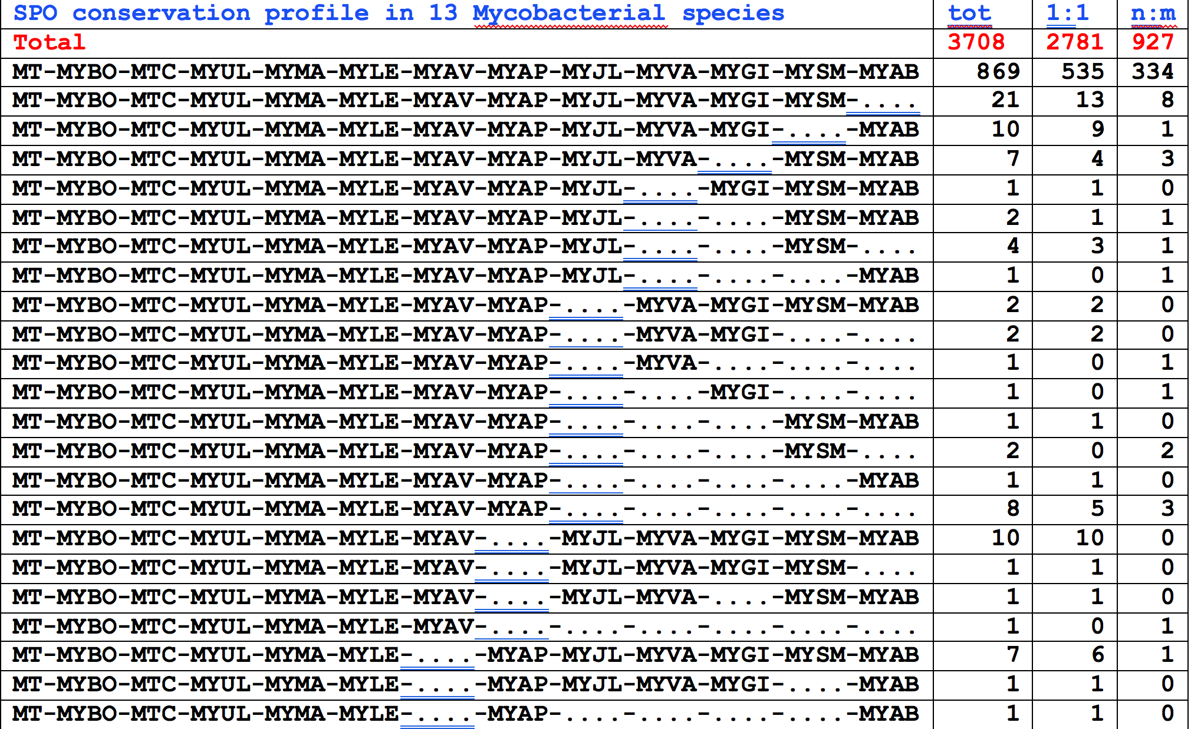

Slide 128
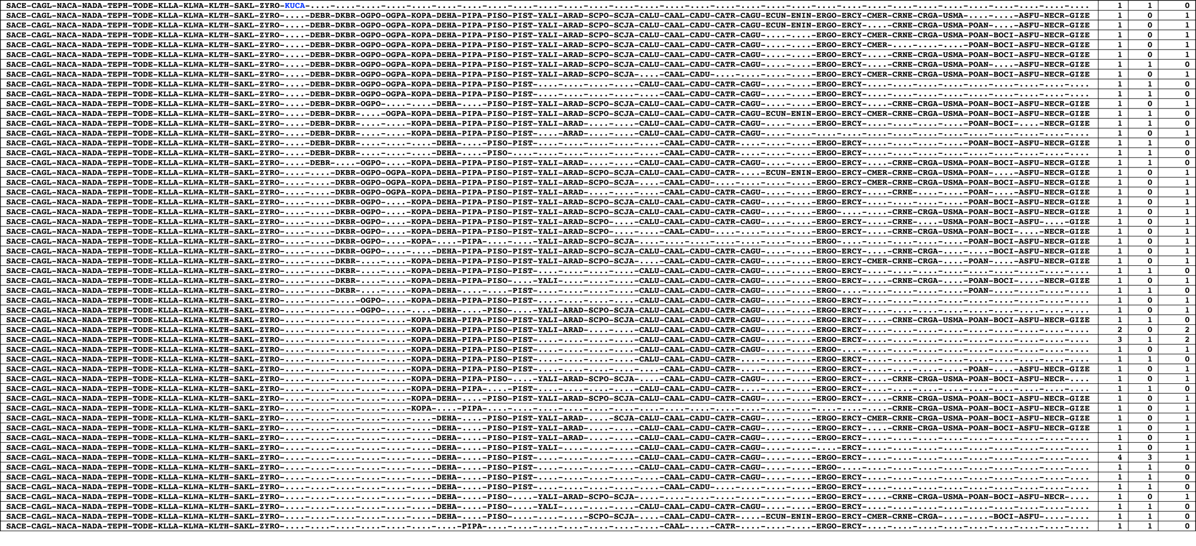

Conservation profiles including KUCA (Kuraishia capsulata)
Notes:
128

Slide 129

Missing genes
=> Transfer between KUCA and distant fungi

Slide 130
Summary: gene relationships
Homologs = Genes of common origin;
Orthologs = Genes resulting from a speciation event;
Co-orthologs = Orthologs that have undergone lineage-specific gene duplications subsequent to a particular speciation event;
Paralogs = Genes resulting from gene duplication;
Inparalogs = Paralogs resulting from lineage-specific duplication(s) subsequent to a particular speciation event;
Outparalogs = Paralogs resulting from gene duplication(s) preceding a particular speciation event;
One-to-one (1:1) orthologs = Orthologs with no (known) lineage-specific gene duplications subsequent to a particular speciation event;
One-to-many (1:n) orthologs: Orthologs of which at least one - and at most all but one - has undergone lineage-specific gene duplication subsequent to a particular speciation event;
Many-to-many (n:n) orthologs = Orthologs which have undergone lineage-specific gene duplications subsequent to a particular speciation event;
Pseudo-orthologs = Paralogs with lineage-specific gene loss of orthologs;
Xenologs = Orthologs derived by horizontal gene transfer from another lineage.

Slide 131
SPOs Conservation Profiles

Slide 132

SPO conservation profiles in Yeast & fungi

Slide 133


Slide 134
Practical sessions
(see ppt preseantation and Text)

Slide 135
Plan
I- Large-scale Genomes Analyses
(knowledge so far acquired)
II- Horizontal Gene Transfer
III- Orthologs, paralogs inference and clustering methods
(context - difficulties – limitations)
IV- Phylogeneomics …
V- Genomic variation

Slide 136

Genome Trees - Phylogenomics
Notes:
136

Slide 137




Martin & Embley
Nature 431:152-5.(2004)
The two-empire proposal, separating eukaryotes from prokaryotes and eubacteria from archaebacteria. Mayr, D. PNAS 95:9720-23. (1998).
The three-domain proposal based on the ribosomal RNA tree. Woese et al. PNAS. 87:4576-4579. (1990)
The ring of life, incorporating lateral gene transfer but preserving the prokaryote eukaryote divide.
Rivera & Lake JA. Nature 431: 152-5. (2004)
The three-domain proposal, with continuous lateral gene transfer among domains.
Doolittle. Science 284:2124-8. (1999)
Notes:
137

Slide 138
Ancestral duplication and ancestral conservation
W_{ij}
W_{ij}
• genome similarity
• shared orthologs
Notes:
138

Slide 139

Tekaia, Lazcano & Dujon (1999)
Genome Research 9: 550-7.
B
A
E
Notes:
139

Slide 140
Conservation profiles
• 99 species (B: 33; A: 19; E:27); 541880 proteins
p 0111111000111111111000110110111101001111101111
• A “conservation profile” is an n-component binary vector describing a protein conservation pattern across n species.
Components are 0 and 1, following absence or presence of homologs.
Main interesting properties of conservation profiles:
• Conservation profiles are signatures of evolutionary relationships;
• A conservation profile is the trace of protein evolutionary histories jointly captured in a set of n species (multidimensional feature);
Tekaia F, Yeramian E. (2005). PLoS Comput Biol.1(7):e75

Slide 141
Protein conservation profiles
E A B
S₁..............I.............I................S_{n}
G_{1,1} 100000000000000000000000000000000000000000000000
G_{2,1} 111111111111111111111111111111111111111111111111
G_{3,1} 111111110011111111111111011101110101111111101111
.......................................................
G_{n1,1} 100001110001000000000000000000000000000000000000
G_{1,2} 010000000000000000010100000000000111000011100011
G_{2,2} 010000000000000000010100000000000111000011100011
........................................................
G_{n2,2} 111111110011111111111111011101110101111111101111
........................................................
G_{1,n} 011110100000000000000000001000000000000000000001
G_{2,n} 111111110011111111100011011101110101111111101111
G_{3,n} 111111110011111111100011011101110101111111101111
........................................................
G_{np,n} 100110000000000000000000000000000000000000000001
Table : 541880 proteins x 99 species
• Different conservation profiles represent different evolutionary histories
Tekaia F, Yeramian E. (2005). PLoS Comput Biol.1(7):e75
Notes:
141

Slide 142
Genome trees: data matrices
T = {T_{ij} ; i=1,n; j=1,n; n is the number of surveyed species}
T_{ij} is the overall similarity score between species j and i.
• Jaccard similarity scores
{ s_{ij} = N₁₁/(N₁₁+N₀₁+N₁₀); }
{s_{ij} = (Jaccard similarity score between species i and j) }
T = { T_{ij} = 100*s_{ij} ; i=1,n; j=1,n}
184130 distinct conservation profiles

Slide 143

profiles tree
Tekaia F, Yeramian E. (2005).
PLoS Comput Biol.1(7):e75
Notes:
143

Slide 144
Phylogenomic tree
• Based on concatenation of a gene sample common to the considered species
Example: n species S₁,..,S_{n} sharing 5 genes
g₁
g₂
g₃
g₄
g₅
S₁
.
.
S_{n}
Limitations:
• genes don't evolve at the same rate nor in the same way;
• a limited number of genes are shared among all species;
Dagan and Martin. Genome Biology, 7:118. The tree of one percent (2006)
Notes:
144

Slide 145


Summary
145
Koonin EV.Annu Rev Genet. 2005;39:309-38. Review.

Slide 146
Reference
Other presentations on orthologs can be found and downloaded from the course web page:
http://www.pasteur.fr/~tekaia/BCGA_WProgs.html
Tekaia. F. Inferring Orthologs: Open Questions and Perspectives.
Genomics Insights 2016:9 17–28 doi:10.4137/GEI.S37925.

Slide 147

Systematic search for minimal sized repeated large motifs (size > 30 aa) in 21 fungal species
Tekaia F, Dujon B, Richard GF. (2013). Detection and characterization of megasatellites in orthologous and nonorthologous genes of 21 fungal genomes. Eukaryot Cell. 12:794-803.

Slide 148
Whole genome alignments

Slide 149

Multiple whole genome alignments
Aaron E. Darling, Istvan Miklos, Mark A. Ragan (2008). Dynamics of Genome Rearrangement in Bacterial Populations. PLoS Genet. 2008 July; 4(7): e1000128.

Slide 150
Whole Alignment of two genomes
Translocation
Inversion
Insertion
B
A
B
• Synteny detection
• Genomic Repeats detection
http://cbcb.umd.edu/.../Lecture10_MUMmer_alignment.ppt
A

Slide 151



Whole genome alignments
LAGAN
Multi-LAGAN
http://lagan.stanford.edu/lagan_web/index.shtml
Three main steps:
1.Generation of local alignments.
2. Construction of a rough global map.
3. Computation of the final global alignment.

Slide 152

Whole genome alignments
• MUMmer (Maximal Unique Matcher)
http://mummer.sourceforge.net/
http://gel.ahabs.wisc.edu/mauve/

Slide 153
Visualization tools

Slide 154

Genomic data visualization with CIRCOS
http://circos.ca/

Slide 155

Artemis: Genome Browser and Annotation Tool
http://www.sanger.ac.uk/resources/software/artemis/

Slide 156
Plan
I- Large-scale Genomes Analyses
(knowledge so far acquired)
II- Horizontal Gene Transfer
III- Orthologs, paralogs inference and clustering methods
(context - difficulties – limitations)
IV- Phylogeneomics …
V- Genomic variation

Slide 157

Genomic Variation
Sequence versus Structural Variation
http://www.ensembl.org/info/genome/variation/

Slide 158
Genomic Variation
Is comprised of:
• Single nucleotide variants
• Large structural variants

Slide 159

Sequence variants:

Slide 160




Structural variants (>= 50 bases):
The full list of variants in Ensembl can be found at this link:
http://www.ensembl.org/info/genome/variation/data_description.html#classes

Slide 161
• It is estimated that about 12% of the genome in human populations is subject to copy number change.
• So far, approximately half of the reported CNVs overlap with protein regions.
• CNVs and SNVs do not necessarily have a negative effect on human health. However, among the large number of CNVs, some might have an association with, or directly involve in diseases and phenotype such as cancer and neuropsychiatric disorders.
Redon R et al. Global variation in copy number in the human genome. Nature 2006; 444:444-454.
Sebat J et al. Large-scale copy number polymorphism in the human genome. Science 2004, 305:525-528.

Slide 162
There are currently 22 variation databases in Ensembl:
See statistics:
http://www.ensembl.org/info/genome/variation/data_description.html#classes
Including for human, mouse, rat, chimpanzee, orangutan, chicken, cat, horse,….

Slide 163
Resources for mining variants:
See also: Databases of genomic variation and phenotypes: existing resources and future needs.Johnston JJ, Biesecker LG.Hum Mol Genet. 2013;22(R1):R27-31. Review.

Slide 164
Resources for mining Variants
Cancer:
Plants:
• 1001genomes.org (A. thaliana)
• www.onekp.org (1000 plants genomes)
Notes:
The cBioPortal for Cancer Genomics provides visualization, analysis and download of large-scale cancer genomics data sets.

Slide 165
Computational tools for copy number variation (CNV) detection using next-generation sequencing data: features and perspectives
http://bmcbioinformatics.biomedcentral.com/articles/10.1186/1471-2105-14-S11-S1

Slide 166
Work environment
• in silico research in Biology
• Unix/Linux based
• perl/python
• C langage
• Internet significant capacities
• be prepared for Big Data genomics
• Statistical/multidimensional methods
• Algorithmics/Mathematics

Slide 167
Challenges and Perspectives
• Bioinformatics is a fascinating research domain offering many opportunities for Biologists, Mathematicians, Statisticians, Computer scientists and soon for doctors, Clinicians,…
Soon: Biology in silico with discovery applications in wet Labs.
• Bioinformatics & Computational Biology
• Education & Training
Formal courses should be set

Slide 168
Five domains of genomics research:
-Understanding the genome structure
-Understanding the biology of genomes
In Human:
From base pairs to bedside
-Understanding the biology of disease
-Advancing the Science of Medecine
-Improving the Effectiveness of Healthcare
Green ED et al. 2011.
Charting a course for genomic medicine from base pairs to bedside. Nature. 470:204-13.

Slide 169
Emerging terms:
Translational Science
Translational bioinformatics
Translational genetics
Translational genomics
Translational Bioinformatics
http://www.ploscollections.org/article/browse/issue/info%3Adoi%2F10.1371%2Fissue.pcol.v03.i11

Slide 170
References:
• Tekaia, F. and Dujon, B. (1999).
Pervasiveness of gene conservation and persistence of duplicates in cellular genomes. Journal of Molecular Evolution, 49:591-600.
• Tekaia, F., Lazcano, A. and B. Dujon (1999). Genome tree as revealed from whole proteome comparisons. Genome Res. 12:17-25.
• Tekaia, F., Yeramian, E. and Dujon, B. (2002).
Amino acid composition of genomes, lifestyles of organisms, and evolutionary trends: a global picture with correspondence analysis. Gene 297: 51-60.
• Tekaia, F. and Yeramian, E. (2005).
Genome Trees from Conservation Profiles. PLoS Comput Biol.1(7):e75.
• Tekaia, F. and Yeramian, E. (2006).
Evolution of Proteomes: Fundamental signatures and global trends in amino acid composition. BMC Genomics. 2006 Dec 5;7:307.

Slide 171
F. Tekaia, G. Blandin, A. Malpertuy, et al. (2000):
Methods and strategies used for sequence analysis and annotation.
FEBS 487,1:17-30.
- A. Malpertuy, F. Tekaia, S. Casaregola, et al. (2000):
«Yeast specific» genes. FEBS 487,1:113-121.
G. Blandin, P. Durrens, F. Tekaia, et al. (2000).
The genome of Saccharomyces cerevisiae revisited. FEBS 487,1:31-36.
Tekaia F, Latge JP Aspergillus fumigatus: saprophyte or pathogen? (2005)
Curr Opin in Microb 8 (4): 385-392.
-Dujon et al. (2004) Genome Evolution in Yeasts Nature. 430: p. 35-44.
- Nierman et al. (2005) Genomic sequence of the pathogenic and allergenic filamentous fungus Aspergillus fumigatus.
Nature. 438:1151-6.

Slide 172
Tekaia F, Yeramian E. (2011).
SuperPartitions: detection and classification of orthologs.
Gene. 2012 Jan 15;492(1):199-211. doi: 10.1016/j.gene.2011.10.027.
Tekaia F, Dujon B, Richard GF. (2013).
Detection and characterization of megasatellites in orthologous and nonorthologous genes of 21 fungal genomes.
Eukaryot Cell. 2013 Jun;12(6):794-803. doi: 10.1128/EC.00001-13.
Tekaia F. (2016).
Inferring Orthologs: Open Questions and Perspectives.
Genomics Insights. 2016 Feb 25;9:17-28. doi: 10.4137/GEI.S37925. eCollection 2016. Review.
Tekaia F. (2016).
Genome Data Exploration Using Correspondence Analysis.
Bioinform Biol Insights. 2016 Jun 7;10:59-72. doi: 10.4137/BBI.S39614. eCollection 2016. Review.

Slide 173
Thank You

Slide 174
Practical sessions
(see text)

